Slide 1
Controlling the optical properties of
composite multilayered photonic
Structures: effect of superposition
By
Anupam Mukherjee
Collaborated with:
A. David Ariza-Flores¹ R. Fabiola Balderas-Valadez² and Vivechana Agarwal²,
¹CIICAp, UAEM, Av. Universidad 1001 Col. Chamilpa, Cuernavaca, Morelos 62210, Mexico² Department of Physics, Facultad de Ciencias, UAEM, Av. Universidad 1001 Col. Chamilpa, Cuernavaca, Morelos 62210, Mexico

Slide 2
Contents
Introduction
Theory:
Sequential (SQ) addition
Superposition (SP) addition
Experimental results
Extension to other photonic filters
Conclusion
Acknowledgment

Slide 3
Introduction:
Photonic structures have ability to control propagation of light.
Dielectric reflectors are preferred due to low absorption of light.
Materials used: polystyrene-tellurium, SiO₂/ZrO₂, TiO₂/SiO₂, porous silicon(PSi)[1,2]
Psi structures are easy to fabricate and has relatively economical preparation method[3].

Slide 4
Introduction:
Photonic structures like Broad band Bragg mirrors, high quality micro-cavities, sharp rugate filters etc., used as filters and sensors[1].
To obtain a multiple-peak optical response from the same photonic structure.
Reduction in physical thickness of the filter amounts to its greater applicability

Slide 5
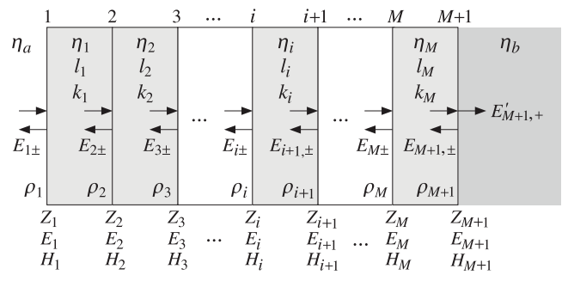
Theory: Multiple Dielectric Slabs
Consider an electric field is linearly polarized and falls on the dielectric surface normally[1].
$τ_{i}= \frac{ρ_{i}+ τ_{i+1} e^{−2j{k_{i}l}_{i }^{}}}{1+ ρ_{i}τ_{i+1}e^{−2jk_{i}l_{i}} }$
$$ρ_{i}= \frac{n_{i−1} − n_{i}}{n_{i−1}+n_{i}}$$
(Reflection coefficient)
reflection response,
and

Slide 6
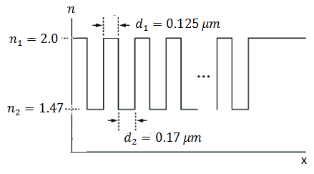
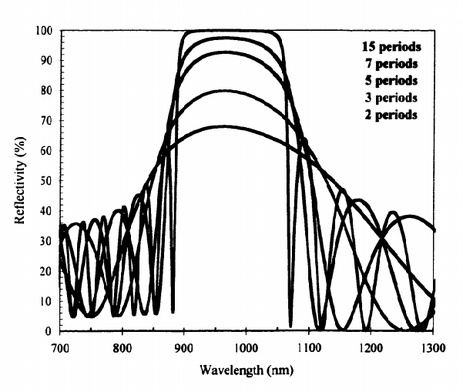
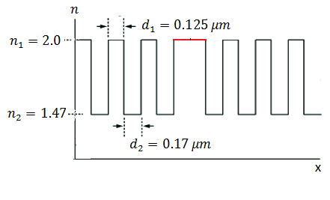
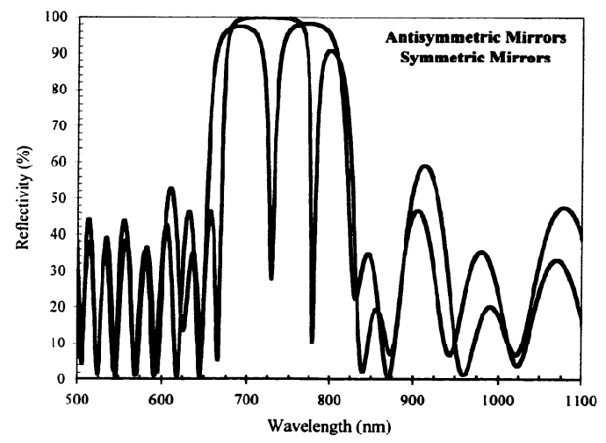
Refractive index profile functions
Bragg Mirror:
A Bragg mirror consists of alternating high and low refractive index, the reflectivity of the mirror has a high reflectivity stop band
The operating wavelength is given by
$$n_{1}d_{1}= n_{2}d_{2}=λ/4$$
Sharpness of the reflectivity depends upon number of periods and
$$Δn$$
Optical Micro cavity
Two multilayer separated by an active layer.
The reflectivity spectrum has a characteristic double peak with a sharp dip between the two maxima
$$x^{′}= λ/2$$
Anti-symmetric mirror: air |n1/n2/n1/n2…|ALP| n1/n2… |Si sub
Symmetric mirror: air |n1/n2/n1/n2…|ALP| n2/n1… |Si sub

Slide 7
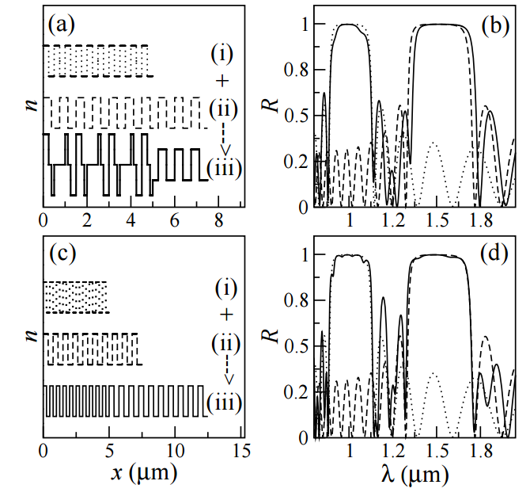
Addition Principle
Multiple-peak optical response from the same photonic structures:
Sequential Addition (SQ): Refractive index of two Bragg mirror joined one after another. Resultant composite structures shows two peak at two different operating wavelength.
Superposition Addition: $n_{sum}= \sum_{i=1}^{N}{n_{i}\left(x\right)−\left(N−1\right)<c>}$ , $n_{H} and n_{L}$ kept same for all functions
Fig 1(a) and 1(c) show the schematics of the refractive index profiles.
The Bragg mirrors has 10 period step function and $n_{H}=2.0 and n_{L}=1.47.$
The operating wavelengths are $λ_{1}=1.0μm and λ_{2}=1.5.$
Figures 1(b) and 1(d) show the reflectivity spectra of the composite structures by SP and SQ addition.
There is a slight red shift and qualitatively more flat photonic band gap (PBG) (Fig 1(b)) in SP addition.
The total optical thickness of the composite SP structure and the SQ are 4488 nm and 7351 nm.

Slide 8
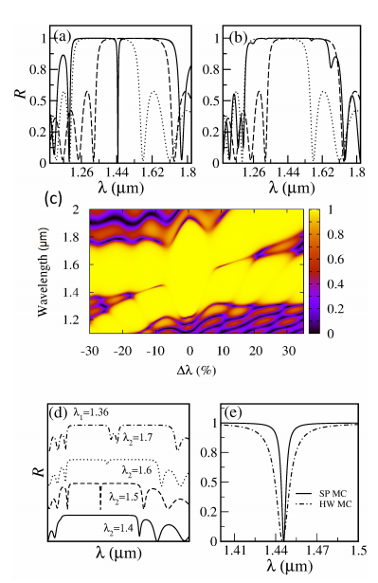
Addition: Overlapping
Consider two closely located operating wavelength $λ_{1}=1.5μm and λ_{2}=1.362μm.$
The maximum and minimum refractive indices are 1.8 and 1.45 for both mirrors.
Demonstrate a clear difference through the appearance and absence of the resonant mode SP and SQ addition.
The appearance of a micro-cavity can be attributed to the close overlapping Bragg mirrors.
Figure (c), Contour plot. The first mirror is fixed at $λ_{1}=1.5μm$ and 2nd mirror operating wavelength $λ_{2}$ is varied.
Enhanced Bragg zone $Δλ=\left(−7,9\right)$. Two sharp MC at $Δλ=\left(−15,−7\right)$ and $Δλ=\left(9,17\right)$. Two distinct Bragg mirror zone at $Δλ=\left(−30,−15\right)$ and $Δλ=\left(17,35\right)$.
Figure (d) showing tunability of SP addition.
Figure (e) a comparison between halfwave MC and SP MC.

Slide 9
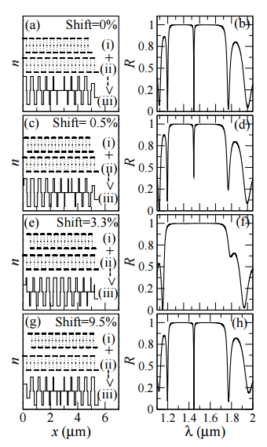
Addition: Shifting
Further controlling: the reflectivity response (R) is calculated as a function of the relative initial position (i.e., shift) between the refractive index profile functions.
The composite SP mirrors have been obtained by overlapping refractive index functions starting from the same position, i. e., p = 0 (0 % shift), to p = 100 shift (equivalent to the SQ addition).
Relative shift is calculated w.r.to longer wavelength.
Significant change in the reflectance properties (R) can be observed with small shift.
Maximum/minimum refractive index of 1.81/1.33, and the resultant composite structure (iii) with maximum/minimum refractive index of 1.09/2.05.
The quality factor found to drop from (207) to (127) with 0.5% of shift.
Relative shift can be used as a control parameter in the design.
A different way to construct Microcavity modes.

Slide 10
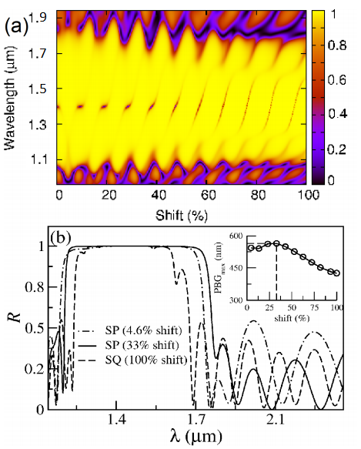
Contour Plot: The reflectivity response (R) is shown as a contour plot with the percentage shift and wavelength (λ).
Periodic appearance of resonant modes are revealed.
For higher value of shift (> 45), the position and the depth of the resonant mode is found to change significantly.
Between the two resonant modes, an enhanced PBG with variable width can be observed.
Figure (b), PBG as a function of percentage shift is found to reveal the existence of an optimum value of shift to obtain the maximum PBG.
The micro-cavity modes shown in the contour plot are equidistant
Periodicity of the superposed mirrors in phase/dephase results in the enhancement/cancellation of the amplitude, generating a Bragg/micro-cavity like photonic structure.

Slide 11
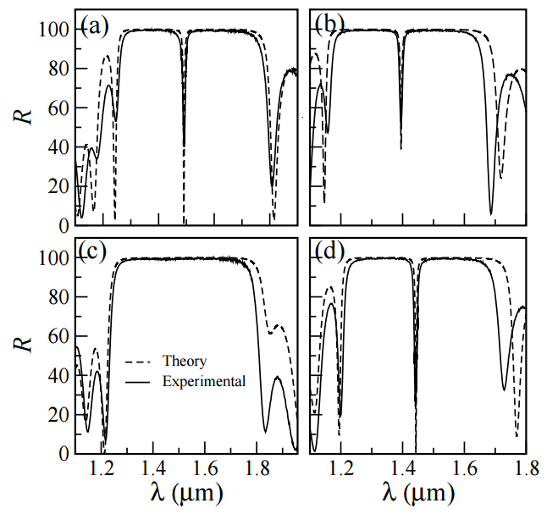
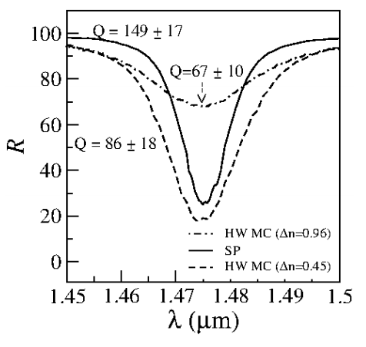
Experimental Results
Two overlapping Bragg mirrors $(λ_{1}=1.5 μm and λ_{2}=1.36 μ)$under SP addition.
The composite structure obtained with (a) 0%, (b) 0.5% (37 nm of optical thickness), (c) 3.3% (247 nm of optical thickness) and (d) 9.5% (712 nm of optical thickness).
Maximum/minimum refractive index 2.05/1.09.
Significant difference in quality factor of the cavities found.
In Fig (a), the experimental micro-cavity mode found to be upto 40% but simulated data shows the complete confinement.
Q factor estimated to be 147/386(th).
In Fig (d), Q factor 149/374(th).
Three samples have been prepared. SP MC (9.5% shift) is compared with 2 HW MC. All the micro-cavities are designed for $λ_{0}=1.47 μm.$ Q(86) MC developed cracks in the PS sample because of wide $Δn.$

Slide 12
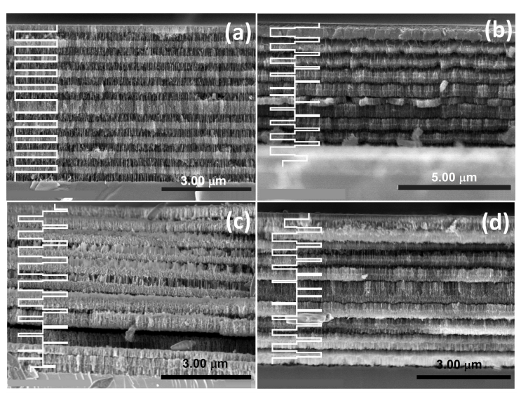
HRSEM cross section of (a) Halfwave micro-cavity (physical thickness of $5.2 μm±0.1\%$.
The dark layer corresponds to high refractive index and light layer corresponds to low refractive index. Left hand side of each image shows the corresponding schematic of the refractive index profile along the depth.
Fig (a), the defect layer is visible in the middle.
Figs (b), (c), (d) obtained through SP addition.
The operating wavelengths are $1.5 μm$ and $1.362 μm$. The composite refractive index function is drawn. Very thin layers are visible.
(b) 0 % shift (physical thickness of 5.4 μm ± 5 %) (c) 3.3% shift (physical thickness of 5.6 μm ± 5 %) (d) 9.5% shift (physical thickness of 5.0 μm ± 5 %)

Slide 13
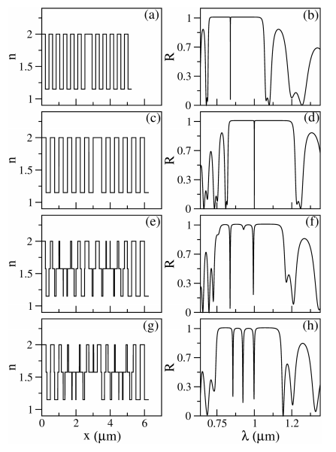
Extension to other photonic filters
Effect of averaging and shifting two MC.
Two ”close” MCs have been designed at $λ_{1}=0.84 μm$ and $λ_{2}=1.0 μm$. We also consider 12 Bragg periods and refractive index as 2.0/1.15.
Fig (f): the composite structures display two MC modes at desired wavelength.
Fig(g): New MC modes appears because of shifting at $λ_{1}=0.92 μm$ .
The quality factor of the MC modes appear to decrease, which can be attributed to effect of averaging.

Slide 14
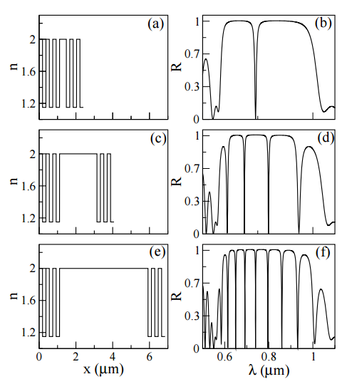
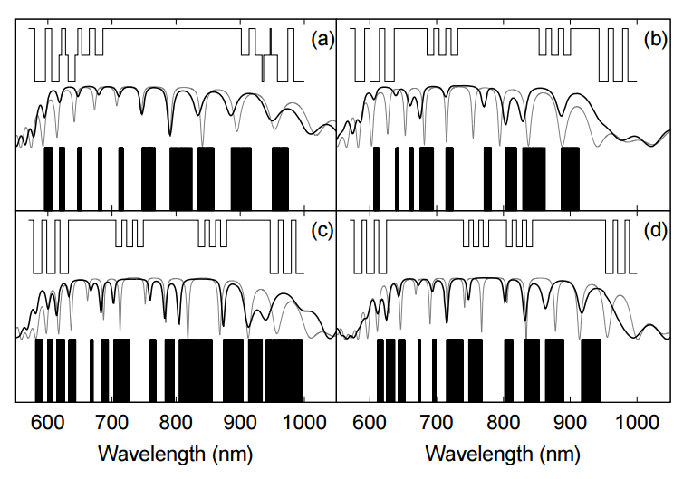
Multi-MC structures designed at wavelengths λ4 = 0.74 μm and λ5 = 0.76 μm [2].
The upper part of each panel represents schematics of R .I profile and middle part corresponds to the reflectivity response and the lower part is the barcode image.
Fig (a)-(d)correspond to 10, 30, 40, and 60 % of shift, respectively.
Multiple mode resonant cavities [1].
This structure was obtained by increasing size of the defect layer.
MC mirrors designed for λ = 0.74 μm.
The defect layer size in Fig (a), (c), (e) are $λ/2$, $6.5λ$, $13λ$.

Slide 15
Conclusion
Superposition (SP) addition of refractive index profiles of 1D photonic structures has been studied for Bragg mirrors.
The study explores new design methods like overlapping of close operating wavelengths and shifting of initial position among the operating wavelength.
SP addition of Bragg mirrors could generate a resonant mode or an enhanced PBG depending upon overlapping or shift.
Theoretical comparison of the resonant mode appearing in the SP structure with the typical half-wave microcavity mode shows an enhancement of quality factor.
PBG as function of percentage shift is found to reveal an optimum value of shift to obtain a maximum PBG.
Experimental verification of some of the simulated results has been demonstrated through PSi multilayers.
Composite structures with high quality factor resonant modes can have possible application in enhancing the sensitivity of porous silicon based filters.

Slide 16
Acknowledgement:
This work has been supported by CONACyT under project 128953 and PROMEP SA/DSA/257/13. The authors acknowledge M. Jose Campos for SEM imaging.
Thank you

