Slide 1





Statistical Mechanics of the Climate System
Valerio Lucarini
valerio.lucarini@zmaw.de
Meteorologisches Institut, Klimacampus, University of Hamburg
Dept. of Mathematics and Statistics, University of Reading
Budapest,September 24th 2013

Slide 2
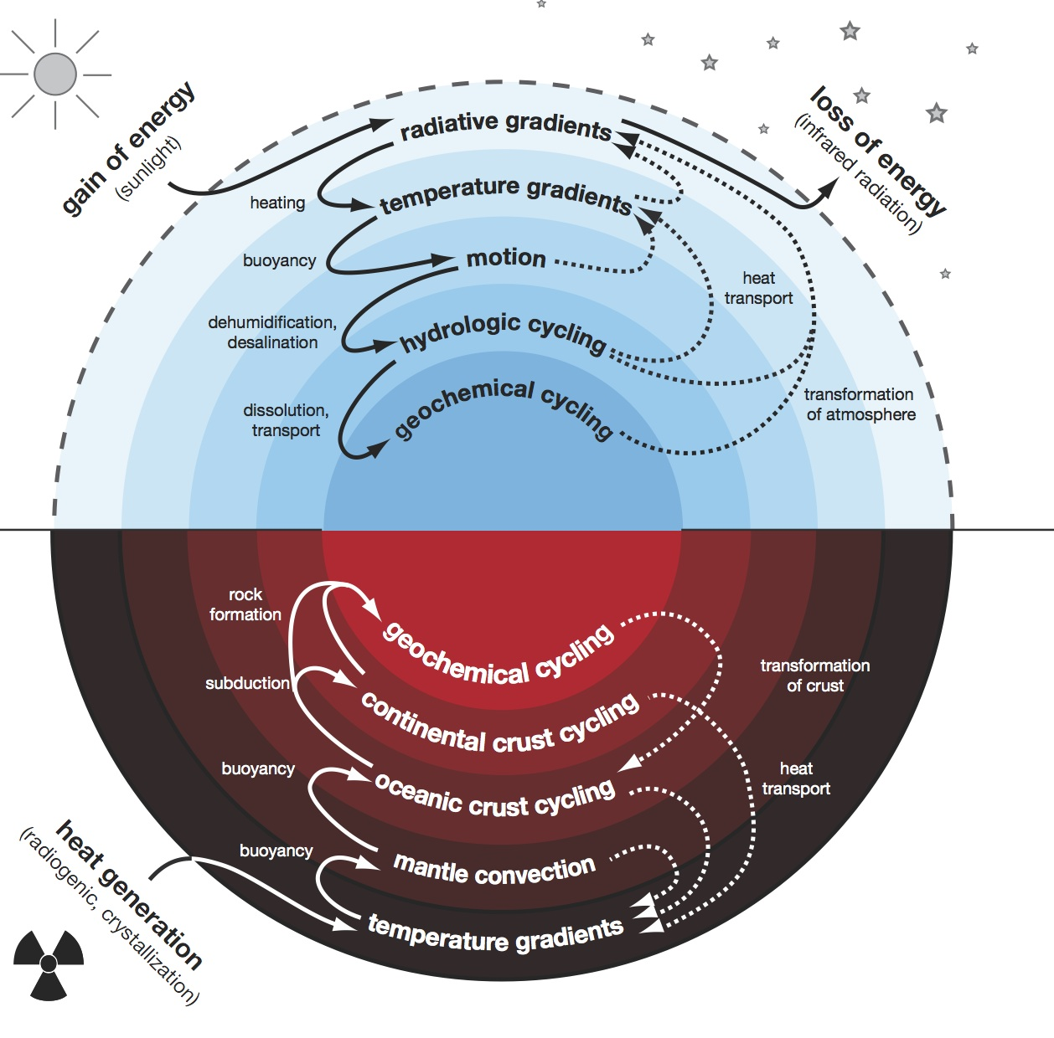

A complex system: our Earth
Nonlinearity
Irreversibility
Disequilibrium
Multiscale
climate
(Kleidon, 2011)

Slide 3
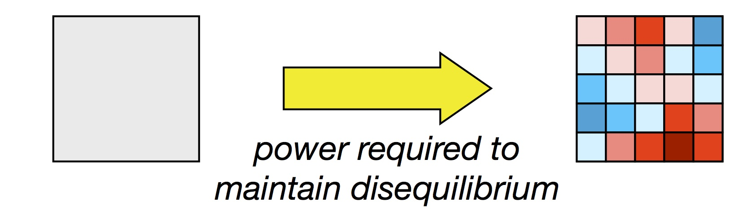
Looking for the big picture
Global structural properties:
  Nonlinearity
  Irreversibility
  Disequilibrium
  Multiscale
Stat Mech & Thermodynamic perspective
  Planets are non-equilibrium thermodynamical systems
  Thermodynamics: large scale properties of climate system;
  Ergodic theory and much more
  Stat Mech for Climate response to perturbations
3
EQ NON EQ

Slide 4
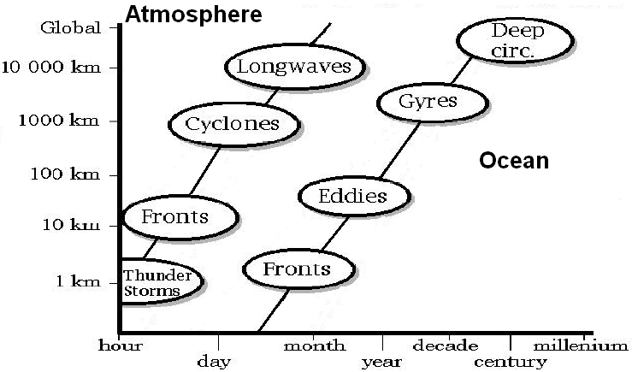
Scales of Motions (Smagorinsky)

Slide 5
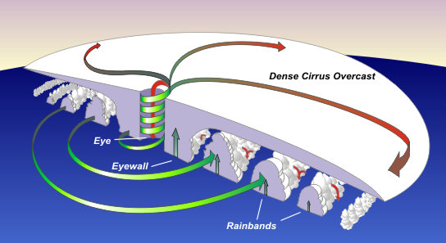
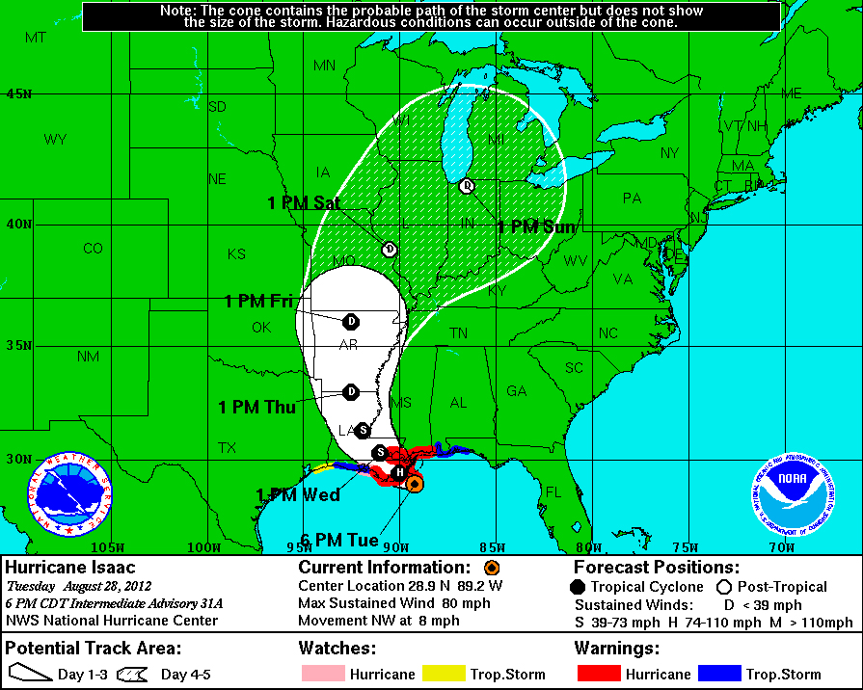
Features/Particles
Focus is on specific (self)organised structures
Hurricane physics/track

Slide 6
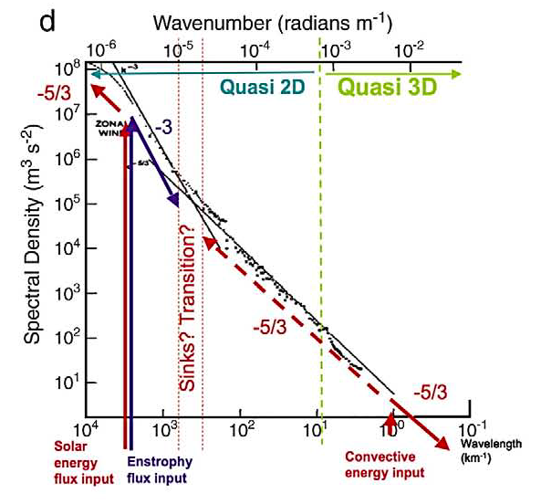
Atmospheric (macro) turbulence
Energy, enstrophy cascades, 2D vs 3D
Note:
NOTHING
is really 2D
in the
atmosphere

Slide 7
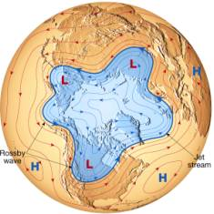
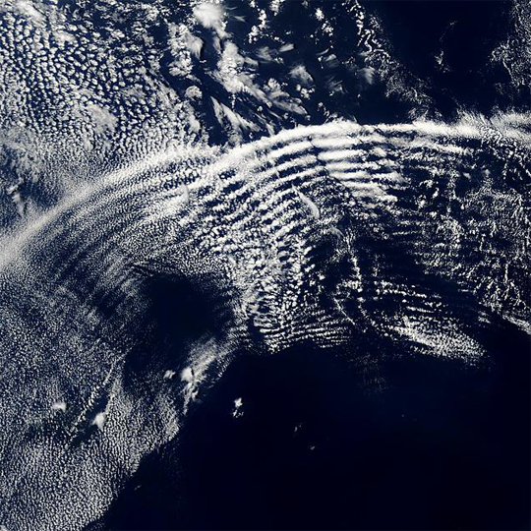
Waves in the atmosphere
Large and small scale patterns

Slide 8
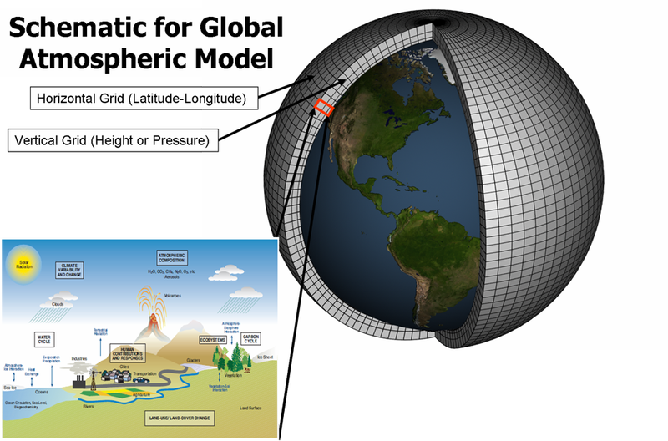

Slide 9
Motivations and Goals
What makes it so difficult to model the geophysical fluids?
  Some gross mistakes in our models
  Some conceptual/epistemological issues
What is a response? What is a parametrization?
  Examples and open problems
Recent results of the perturbation theory for non-equilibrium statistical mechanics
  Deterministic & Stochastic Perturbations
Applications on system of GFD interest
  Lorenz 96 – various observables
Again: what is a parametrization?
  Mori Zwanzig and Ruelle approaches
Try to convince you this is a useful framework even if I talk about a macro-system and the title of the workshop is …

Slide 10
Major theoretical challenges for complex, non-equilibrium systems
Mathematics: Stability prop of time mean state say nothing on the prop of the system
  Cannot define a simple theory of the time-mean properties relying only on the time-mean fields.
Physics: “no” fluctuation-dissipation theorem for a chaotic dissipative system
  non-equivalence of external/ internal fluctuations ➔ Climate Change is hard to parameterise
Numerics: Complex systems feature multiscale properties, they are stiff numerical problems, hard to simulate “as they are”

Slide 11
Response theory
The response theory is a Gedankenexperiment:
  a system, a measuring device, a clock, turnable knobs.
Changes of the statistical properties of a system in terms of the unperturbed system
Divergence in the response ➔ tipping points
Suitable environment for a climate change theory
  “Blind” use of several CM experiments
  We struggle with climate sensitivity and climate response
Deriving parametrizations!

Slide 12
Background
In quasi-equilibrium statistical mechanics, the Kubo theory (’50s) allows for an accurate treatment of perturbations to the canonical equilibrium state
  In the linear case, the FDT bridges the properties of the forced and free fluctuations of the system
When considering general dynamical systems (e.g. forced and dissipative), the situation is more complicated (no FDT, in general)
Recent advances (Ruelle, mostly): for a class of dynamical systems it is possible to define a perturbative theory of the response to small perturbations
  We follow this direction…
We apply the theory also for stochastic forcings

Slide 13
Axiom A systems
Axiom A dynamical systems are very special
  hyperbolic on the attractor
  SRB invariant measure
    time averages ➔ ensemble averages
    Locally, “Cantor set times a smooth manifold”
    Smoth on unstable (and neutral) manifold
    Singular on stable directions (contraction!)
When we perform numerical simulations, we implicitly set ourselves in these hypotheses
  Chaotic hypothesis by Gallavotti & Cohen (1995, 1996): systems with many d.o.f. can be treated as if they were Axiom A when macroscopic averages are considered.
  These are, in some sense, good physical models!!!

Slide 14
Applicability of FDT
For deterministic, dissipative chaotic etc. systems FDT does not work
  It is not possible to write the response as a correlation integral, there is an additional term
  The system, by definition, never explores the stable directions, whereas a perturbations has components also outside the unstable manifold
Recent studies (Branstator et al.) suggest that, nonetheless, information can be retrieved
Probably, numerical noise also helps
  The choice of the observable is surely also crucial
Parametrization

Slide 15
Ruelle (’98) Response Theory
Perturbed chaotic flow as:
Change in expectation value of Φ:
n^{th} order perturbation:

Slide 16


This is a perturbative theory…
with a causal Green function:
  Expectation value of an operator evaluated over the unperturbed invariant measure ρ_{SRB}(dx)
where: and
Linear term:
Linear Green:
Linear suscept:

Slide 17
Kramers-Kronig relations
The in-phase and out-of-phase responses are connected by Kramers-Kronig relations:
  Measurements of the real (imaginary) part of the susceptibility ➔ K-K ➔ imaginary (real) part
Every causal linear model obeys these constraints
K-K exist also for nonlinear susceptibilities
with
Kramers, 1926; Kronig, 1927

Slide 18
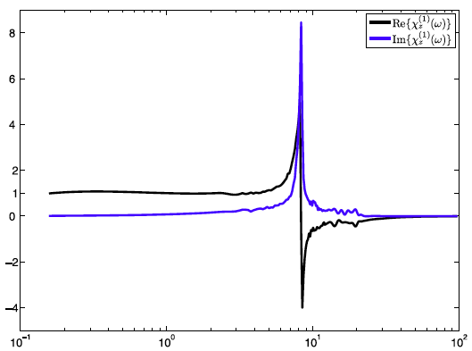
Linear Spectroscopy of L63
Resonances have to do with UPOs

Slide 19
A Climate Change experiment
Observable: globally averaged T_{S}
Forcing: increase of CO₂ concentration
Linear response:
Let’s perform an ensemble of experiments
  Concentration is increased at t=0
Fantastic, we estimate
…and we obtain:
… we can predict future T_{S} … In Progress…

Slide 20
Noise in Numerical Modelling
Deterministic numerical models are supplemented with additional stochastic forcings.
Overall practical goals:
  an approximate but convincing representation of the spatial and temporal scales which cannot be resolved;
  faster exploration of the attractor of the system, due to the additional “mixing”;
  Especially desirable when computational limitations
Fundamental reasons:
  A good (“physical”) invariant measure of a dynamical system is robust with respect to the introduction of noise
    exclusion of pathological solutions;
  Limit of zero noise → statistics of the deterministic system?
  Noise makes the invariant measure smooth
A very active, interdisciplinary research sector

Slide 21
Stochastic forcing
, where is a Wiener process
Therefore, and
We obtain:
The linear correction vanishes; only even orders of perturbations give a contribution
No time-dependence

Slide 22
Some observations
The correction to the expectation value of any observable ~ variance of the noise
  Stochastic system → deterministic system
  Convergence of the statistical properties is fast
We have an explicit formula!

Slide 23
Correlations...
Ensemble average over the realisations of the stochastic processes of the expectation value of the time correlation of the response of the system:
Leading order is proportional to ε²
It is the convolution product of the linear Green function!

Slide 24
So what?
Computing the Fourier Transform we obtain:
We end up with the linear susceptibility...
Let’s rewrite he equation:
So: difference between the power spectra
  → square modulus of linear susceptibility
  Stoch forcing enhances the Power Spectrum
Can be extended to general (very) noise
KK ➔ linear susceptibility ➔ Green function

Slide 25
With some complex analysis
We know that is analytic in the upper complex plane
So is
  Apart from complex zeros...
The real ( ) and imag ( ) obey KK relations
  From the observation of the power spectra we obtain the real part
  With KK analysis we obtain the imaginary part
We can reconstruct the linear susceptibility!
And from it, the Green function

Slide 26
Lorenz 96 model
Excellent toy model of the atmosphere
  Advection
  Dissipation
  Forcing
Test Bed for Data assimilation schemes
Becoming popular in the community of statistical physicists
  Scaling properties of Lyapunov & Bred vectors
Evolution Equations
Spatially extended, 2 Parameters: N & F

Slide 27
Some properties
Let
and
Stationary State:
Closure:
  System is extended, in chaotic regime the properties are intensive
We perform simulations with specific F=8 and N=40, but results are “universal”

Slide 28
Global Perturbation
Observable: e=E/N
We can compute the leading order for both the real and imaginary part
L & Sarno, 2011

Slide 29
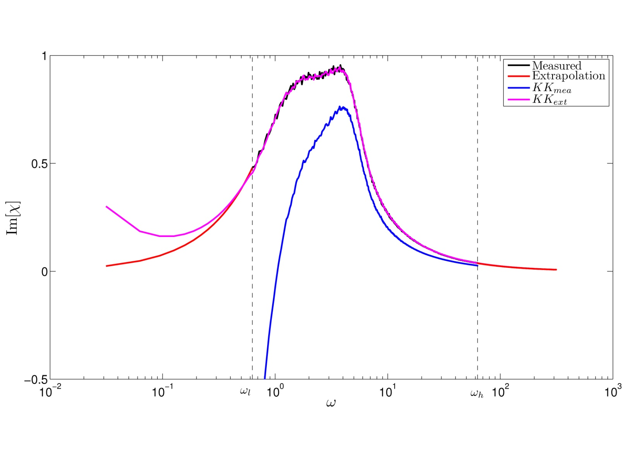
Imag part of the susceptibility
LW
HF
Rigorous extrapolation

Slide 30
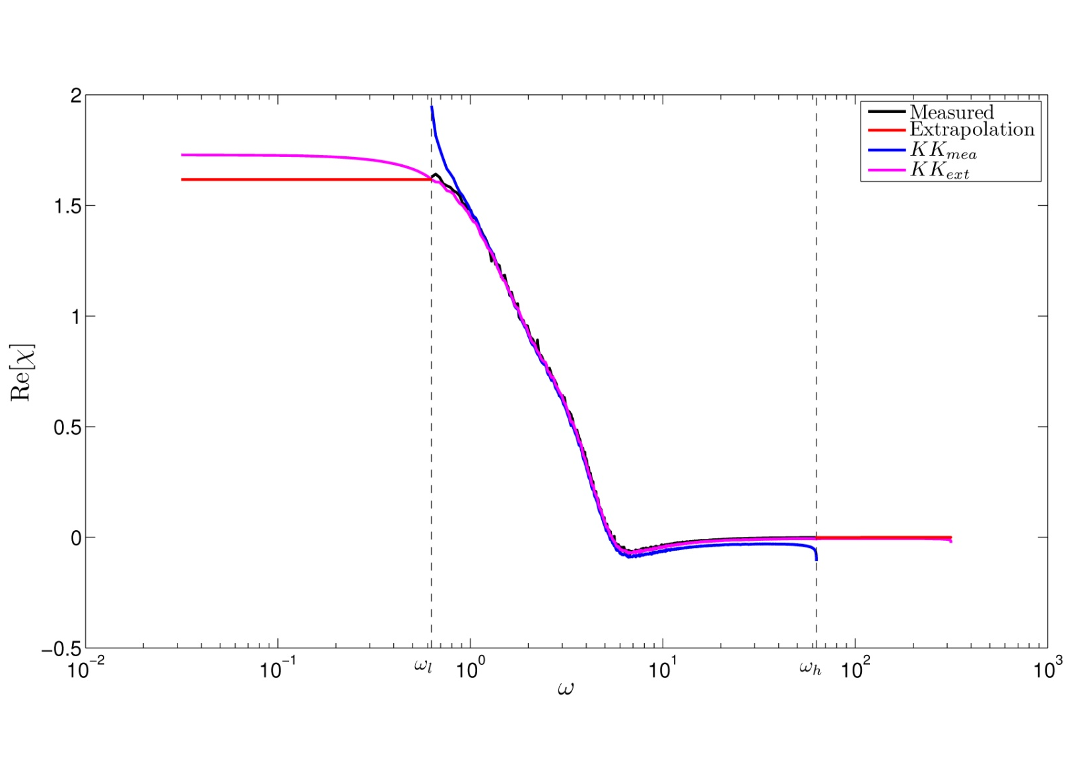
Real part of the susceptibility
LW
HF
Rigorous extrapolation

Slide 31
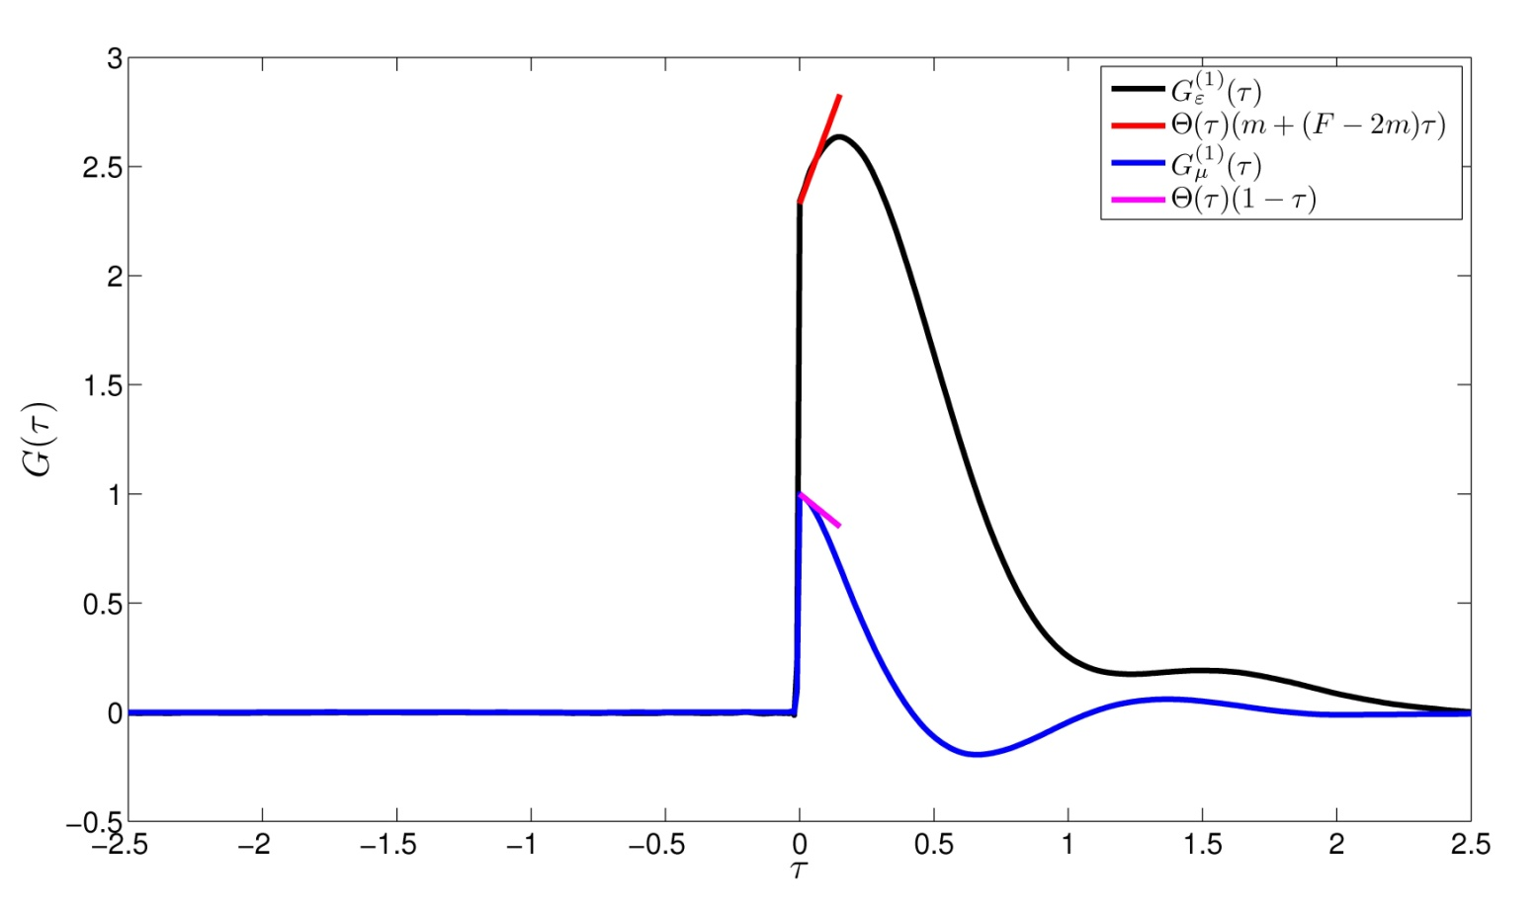
Green Function!
Inverse FT of the susceptibility
Response to any forcing with the same spatial pattern but with general time pattern

Slide 32
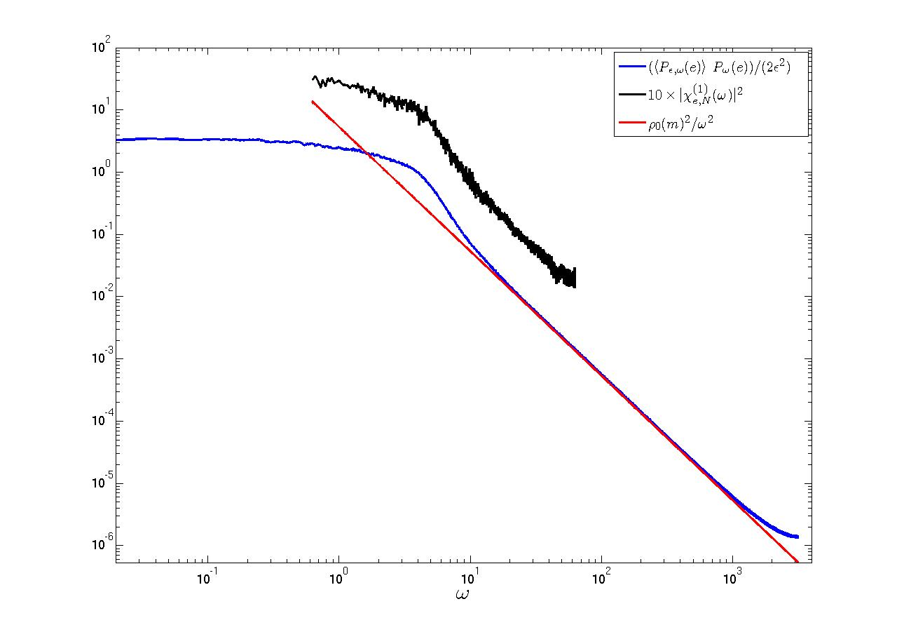
Using stochastic forcing…
Squared modulus of
Blue: Using stoch pert; Black: deter forcing
... And many many many less integrations

Slide 33
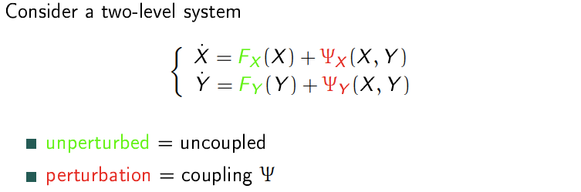
What is a Parametrization?
Surrogating the coupling: Fast➔Slow Variables
Optimising Computer Resources
Underlining Mechanisms of Interaction
How to perform coarse-graining

Slide 34
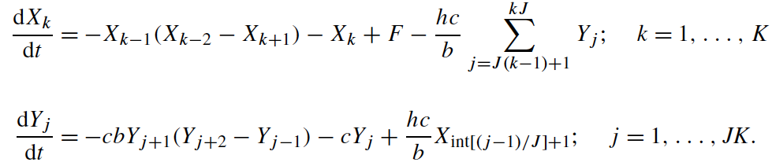
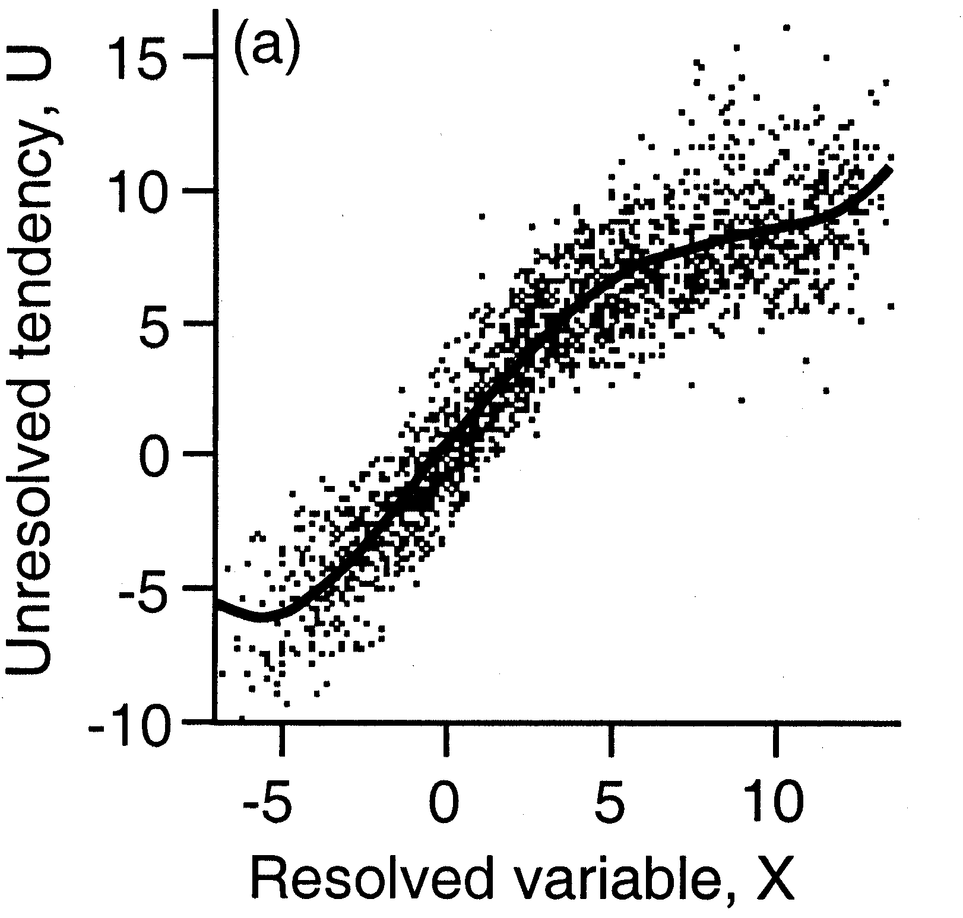
Empirical Parametrization (Wilks ‘05)
Lorenz ‘96 model
Parametrization of Y’s
Deterministic + Stoch
Best Fit of residuals
Have to repeat for each model
Weak coupling

Slide 35
Traditionally…
Parametrizations obtained as empirical closure formulas
  Vertical transport of momentum at the border of the boundary layer as a function of ….
  Evaporation over ocean given ….
These formulas are deterministic functions of the larger scale variables
… or tables are used
Recently, people are proposing stochastic parametrizations in the hope of mimicking better the variability

Slide 36
Conditional Markov Chains
(Crommelin et al.)
Data-inferred conditional Markov chains
U: unresolved dynamics; X: resolved variables
Construct from data a transition matrix
  Strength of the unresolved dynamics given its strength at previous step and the values of the resolved variables at the present & previous steps
  Discretization of the problem for the unresolved dynamics
  Rules constructed from data ➔ memory
  Works also for not-so-weak coupling

Slide 37
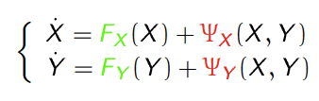
Systematic Mode Reduction (Majda et al.)
Fluid Dynamics Eqs (e.g. QG dynamics)
X: slow, large scale variables
Y: unresolved variables (EOF selection)
Ψ are quadratic
Conditions:
  The dynamics of unresolved modes is ergodic and mixing
  It can be represented by a stochastic process
  all unresolved modes are quasi-Gaussian distributed
One can derive an effective equation for the X variables where is F is supplemented with:
  A deterministic correction
  An additive and a multiplicative noise

Slide 38
Problems
A lot of hypotheses
Impact of changing the forcing?
Impact of changing the resolution?
Parametrization should obey physical laws
  If we perturb q and T, we should have LΔq=C_{p}ΔT
  Energy and momentum exchange
  Consistency with regard to entropy production…
The impact of stochastic perturbations can be very different depending on what variables are perturbed
Assuming a white noise can lead to large error
Planets!

Slide 39
How to Construct a Parametrization?
We try to match the evolution of the single trajectory of the X variables
  Mori-Zwanzig Projector Operator technique: needs to be made explicit
  Accurate “Forecast”
We try to match the statistical properties of a general observable A=A(X)
  Ruelle Response theory
  Accurate “Climate”
Match between these two approaches?

Slide 40
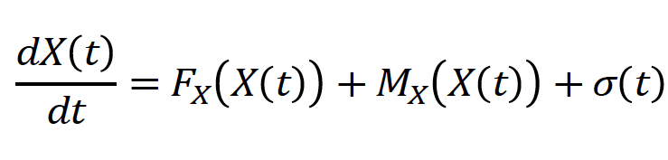
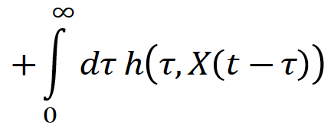
That’s the result!
This system has the same expectation values as the original system (up to 2nd order)
We have explicit expression for the three terms a (deterministic), b (stochastic), c (memory)- 2nd order expansion
a
b
T
O
D
A
Y
c
Deterministic ✓
Stochastic ✓
Memory ✖

Slide 41
Diagrams: 1st and 2nd order
1
2
Coupling
Time
+

Slide 42
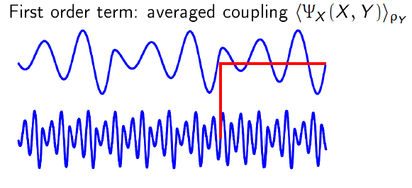
Mean Field
Deterministic Parametrization
  This is the “average” coupling

Slide 43
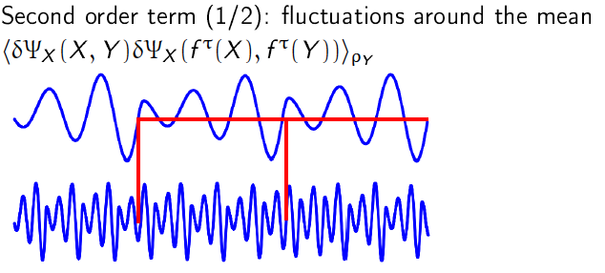
Fluctuations
Stochastic Parametrization
  Expression for correlation properties

Slide 44
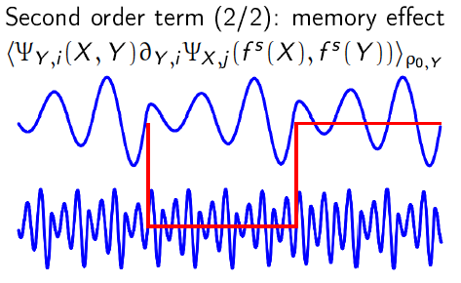
Memory
New term, small for vast scale separation
  This is required to match local vs global

Slide 45
Two words on Mori-Zwanzig
Answers the following question
  what is the effective X dynamics for an ensemble of initial conditions Y(0), when ρ_{Y} is known?
  We split the evolution operator using a projection operator P on the relevant variables
Effective dynamics has a deterministic correction to the autonomous equation, a term giving a stochastic forcings (due to uncertainty in the the initial conditions Y(0)), a term describing a memory effect.
One can perform an approximate calculation, expanding around the uncoupled solution…

Slide 46



Mori-Zwanzig: a simple example (Gottwald, 2010)
Just a 2X2 system:
x is “relevant”
We solve with respect to y:
We plug the result into x:
Markov Memory Noise

Slide 47
Same result!
Optimal forecast in a probabilistic sense
2nd order expansion
Same as obtained with Ruelle
  Parametrizations are “well defined” for CM & NWP
a
b
Memory required to match local vs global
c

Slide 48
Conclusions
We have used Ruelle response theory to study the impact of deterministic and stochastic forcings to non-equilibrium statistical mechanical systems
Frequency-dependent response obeys strong constraints
  We can reconstruct the Green function!
Δ expectation value of observable ≈ variance of the noise
  SRB measure is robust with respect to noise
Δ power spectral density ≈ to the squared modulus of the linear susceptibility
  More general case: Δ power spectral density >0
What is a parametrization? I hope I gave a useful answer
  We have ground for developing new and robust schemes
  Projection of the equations ➔ smooth measure ➔ FDT!
Application to more interesting models
TWO POST-DOC POSITIONS

Slide 49




Slide 50
References
D. Ruelle, Phys. Lett. 245, 220 (1997)
D. Ruelle, Nonlinearity 11, 5-18 (1998)
C. H. Reich, Phys. Rev. E 66, 036103 (2002)
R. Abramov and A. Majda, Nonlinearity 20, 2793 (2007)
U. Marini Bettolo Marconi, A. Puglisi, L. Rondoni, and A. Vulpiani, Phys. Rep. 461, 111 (2008)
D. Ruelle, Nonlinearity 22 855 (2009)
V. Lucarini, J.J. Saarinen, K.-E. Peiponen, E. Vartiainen: Kramers-Kronig Relations in Optical Materials Research, Springer, Heidelberg, 2005
V. Lucarini, J. Stat. Phys. 131, 543-558 (2008)
V. Lucarini, J. Stat. Phys. 134, 381-400 (2009)
V. Lucarini and S. Sarno, Nonlin. Proc. Geophys. 18, 7-27 (2011)
V. Lucarini, T. Kuna, J. Wouters, D. Faranda, Nonlinearity (2012)
V. Lucarini, J. Stat. Phys. 146, 774 (2012)
J. Wouters and V. Lucarini, J. Stat. Mech. (2012)
J. Wouters and V. Lucarini, J Stat Phys. 2013 (2013)

