Slide 1
Macroscopic Thermodynamics: Efficiency, Irreversibility, Tipping Points
Valerio Lucarini
Klimacampus, Meteorological Institute, University of Hamburg
Email: valerio.lucarini@zmaw.de
Budapest, 23/09/2013

Slide 2
Some Properties of Complex Systems
Spontaneous Pattern formation
Symmetry break and instabilities
Irreversibility
Entropy Production
Variability of many spatial and temporal scales
Non-trivial numerical models
Sensitive dependence on initial conditions
limited predictability time

Slide 3
What’s a Complex system?
A complex system is a system composed of interconnected parts that, as a whole, exhibit one or more properties not obvious from the properties of the individual parts
Reductionism, which has played a fundamental role in develpoing scientific knowledge, is not applicable.
The Galilean scientific framework given by recurrent interplay of experimental results (performed in a cenceptual/real laboratory provided with a clock, a measuring and a recording device), and theoretical predictions is challenged

Slide 4
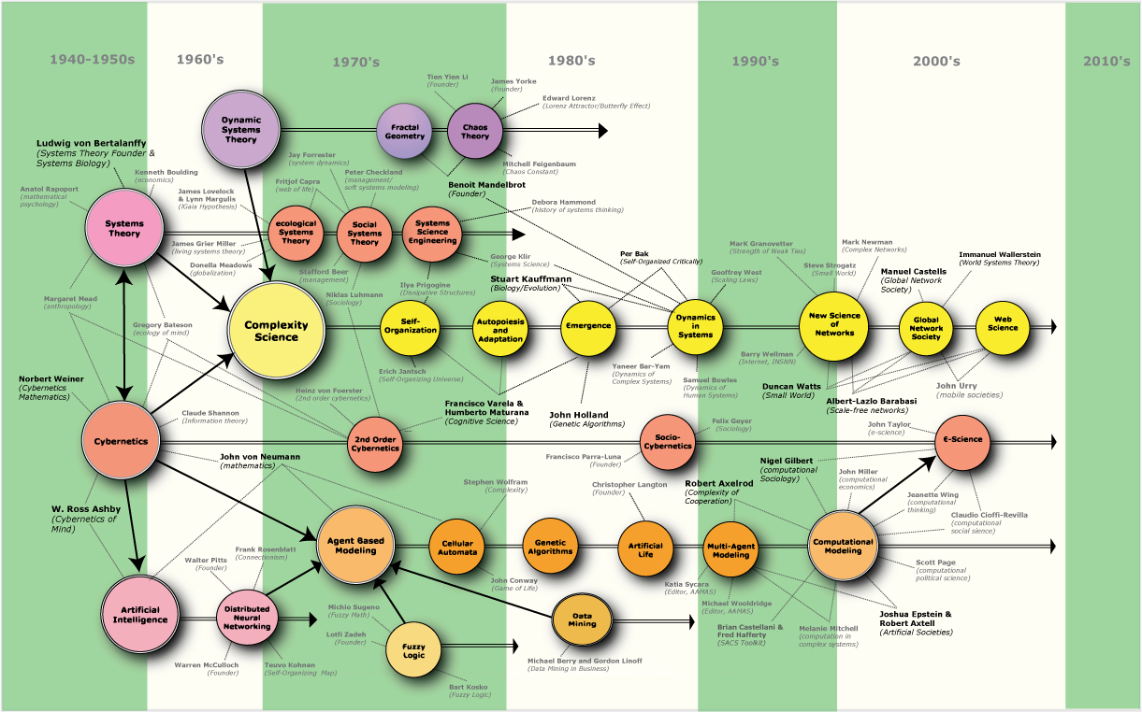
Map of Complexity
Climate Science is mysteriously missing!

Slide 5
Map of Complexity
Climate Science is perceived as being too technical, political
Climate Science

Slide 6
Some definitions
The climate system (CS) is constituted by four interconnected sub-systems: atmosphere, hydrosphere, cryosphere, and biosphere,
The sub-systems evolve under the action of macroscopic driving and modulating agents, such as solar heating, Earth’s rotation and gravitation.
The CS features many degrees of freedom
This makes it complicated
The CS features variability on many time-space scales and sensitive dependence on IC
This makes it complex.
The climate is defined as the set of the statistical properties of the CS.

Slide 7
Climate and Physics
“A solved problem, just some well-known equations and a lot of integrations”
“who cares about the mathematical/physical consistency of models: better computers, better simulations, that’s it!
… where is the science?
“I regret to inform the author that geophysical problems related to climate are of little interest for the physical community…”
“Who cares of energy and entropy? We are interested in T, P, precipitation”

Slide 8
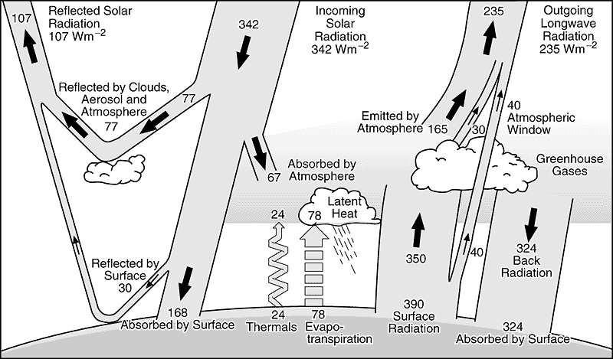
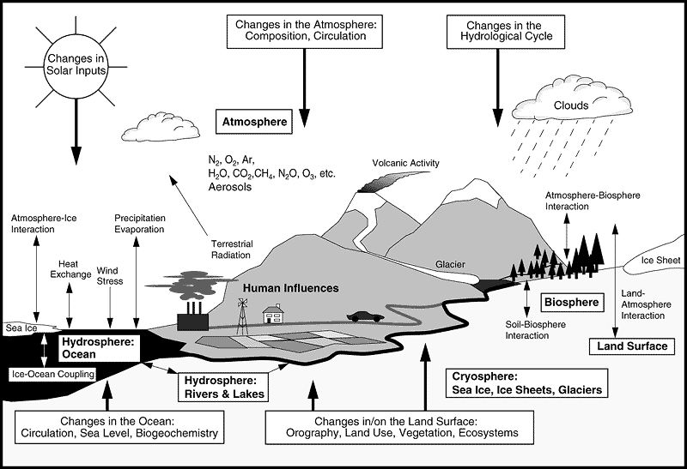
E
N
E
R
G
Y
S
Y
S
T
E
M

Slide 9
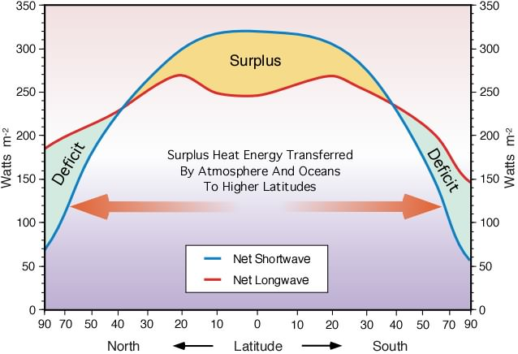
Differential Heating

Slide 10
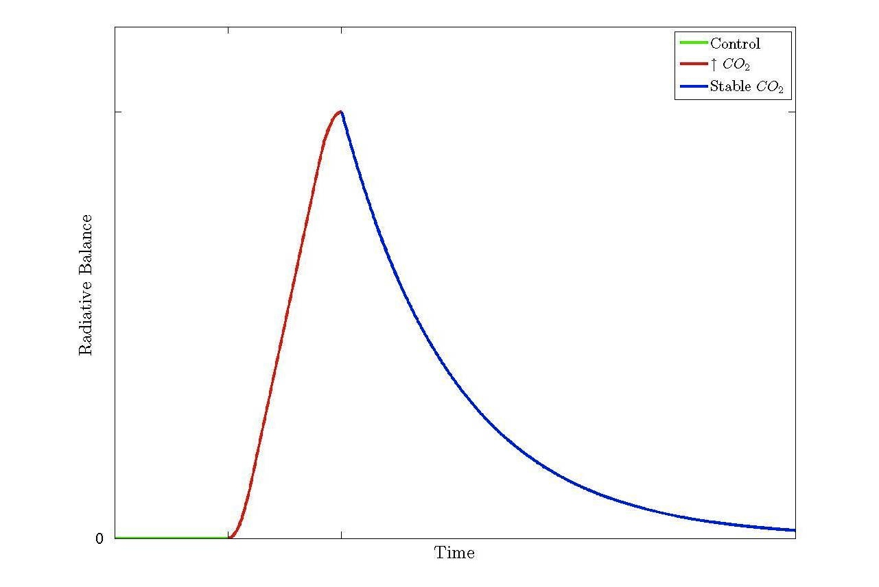
Energy & GW – Perfect GCM
Forcing
τ
L. and Ragone, 2011
Total warming
NESS→Transient → NESS
Applies to the whole climate and to to all climatic subdomains
for atmosphere τ is small, always quasi-equilibrated

Slide 11
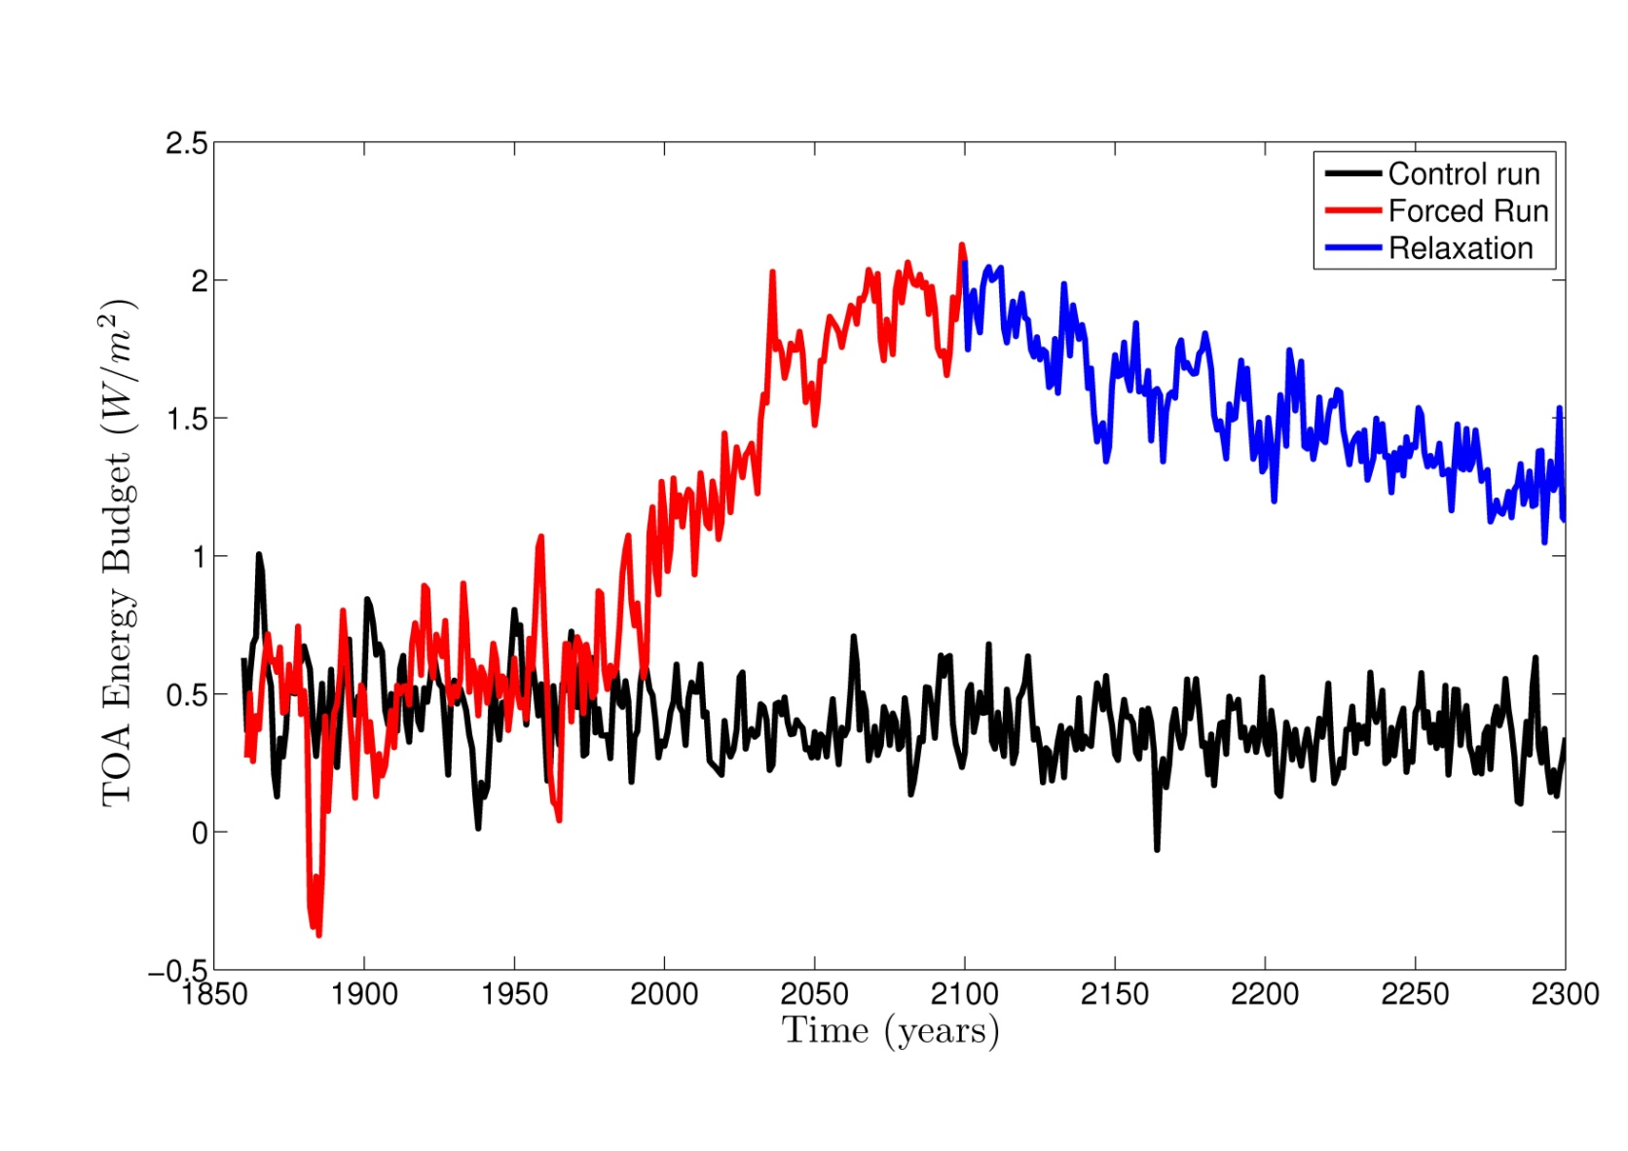
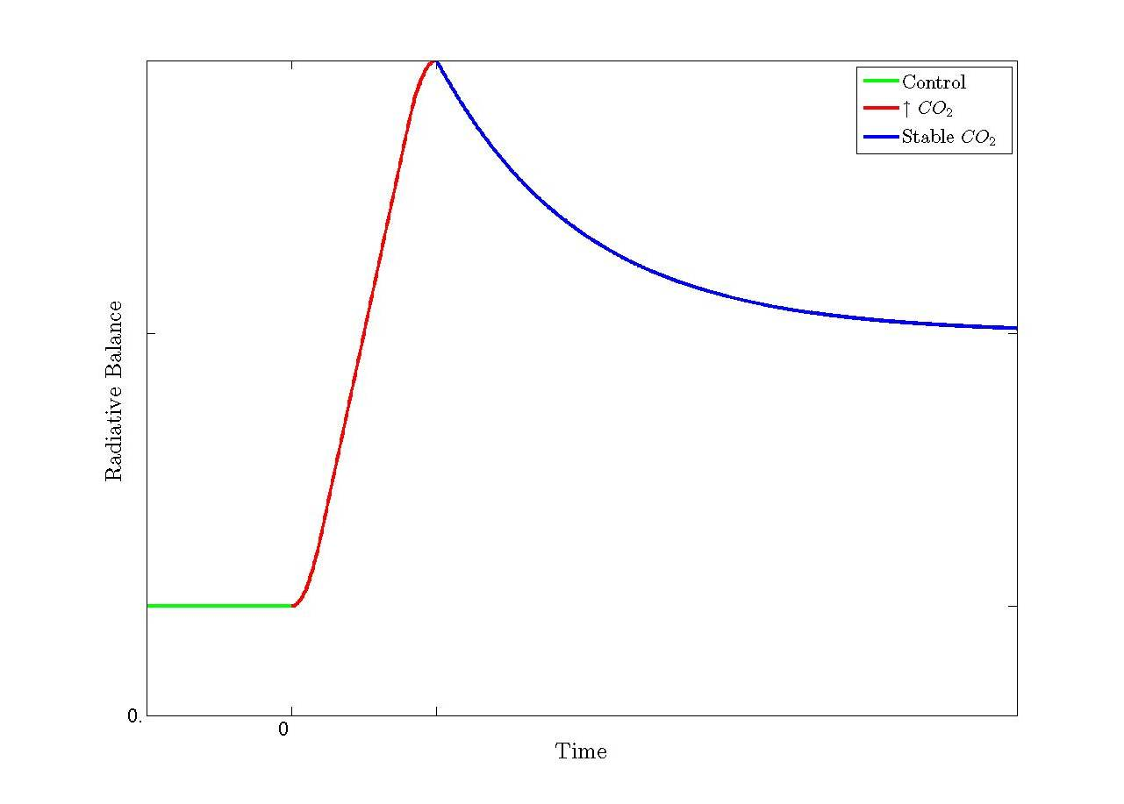
Energy and GW – Actual GCMs
L. and Ragone, 2011
Forcing
τ
Not only bias: bias control ≠ bias final state
Bias depends on climate state! ➔ Dissipation

Slide 12
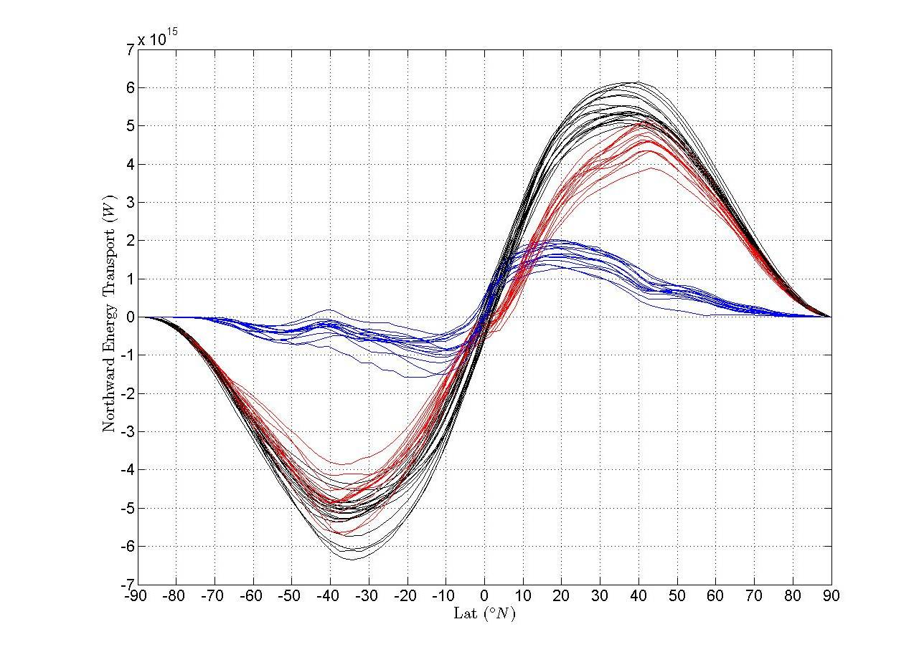
Steady State – Meridional Transports
T
A
O
20% uncertainty among models

Slide 13
Comments
“Well, we care about T and P, not Energy”
Troublesome, practically and conceptually
A steady state with an energy bias?
How relevant are projections related to forcings of the same order of magnitude of the bias?
In most physical sciences, one would dismiss entirely a model like this, instead of using it for O(1000) publications
Should we do the same?
Some conceptual framework is needed

Slide 14
Scales of Motions (Smagorinsky)

Slide 15
Atmospheric Motions
Three contrasting approaches:
Those who like maps, look for features/particles
Those who like regularity, look for waves
Those who like irreversibility, look for turbulence
Let’s see schematically these 3 visions of the world

Slide 16
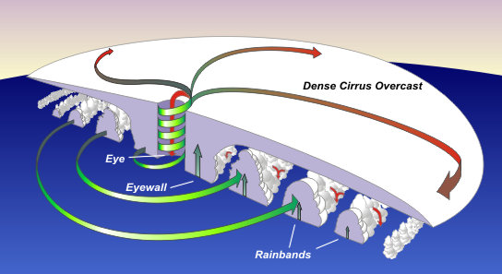
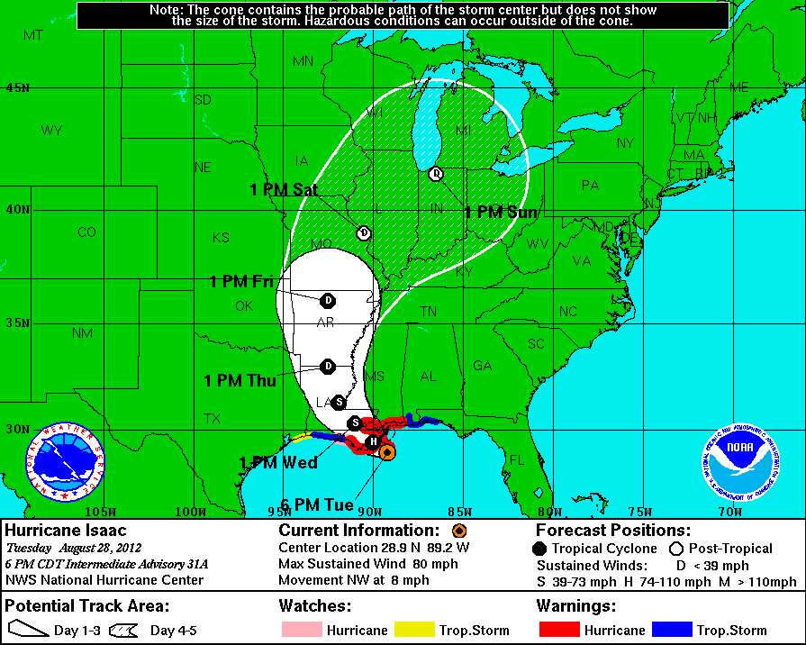
Features/Particles
Focus is on specific (self)organised structures
Hurricane physics/track

Slide 17
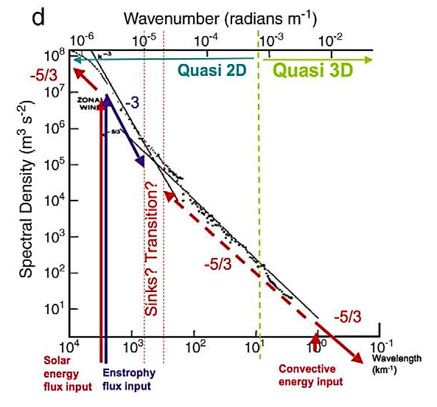
Atmospheric (macro) turbulence
Energy, enstrophy cascades, 2D vs 3D
Note:
NOTHING
is really 2D
in the
atmosphere

Slide 18
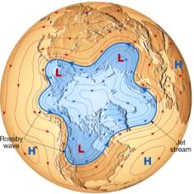
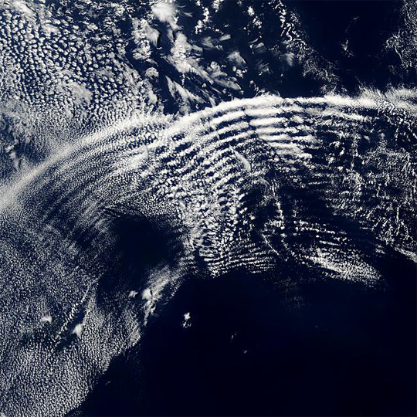
Waves in the atmosphere
Large and small scale patterns

Slide 19
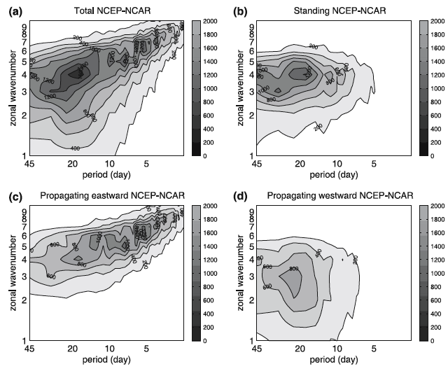
“Waves” in the atmosphere?
Hayashi-Fraedrich decomposition

Slide 20
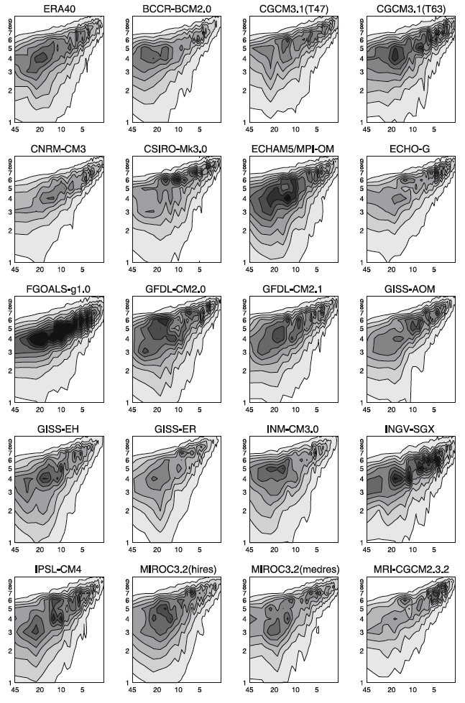
“Waves” in GCMs
GCMs differ in representation of large scale atmospheric processes
Just Kinematics?
What we see are only unstable waves and their effects

Slide 21
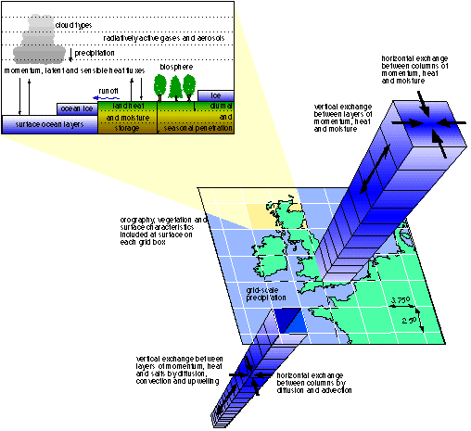
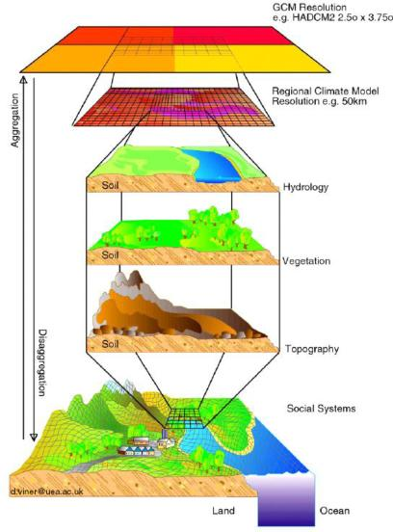
Full-blown Climate Model
Since the ‘40s, some of largest computers are devoted to climate modelling

Slide 22
Plurality of Models
In Climate Science, not only full-blown models (most accurate representation of the largest number of processes) are used
Simpler models are used to try to capture the structural properties of the CS
Less expensive , more flexible – parametric exploration
CMs uncertainties are addressed by comparing
CMs of similar complexity (horizontal)
CMs along a hierarchical ladder (vertical)
The most powerful tool is not the most appropriate for all problems, addressing the big picture requires a variety of instruments
All models are “wrong”! (but we are not blind!)

Slide 23
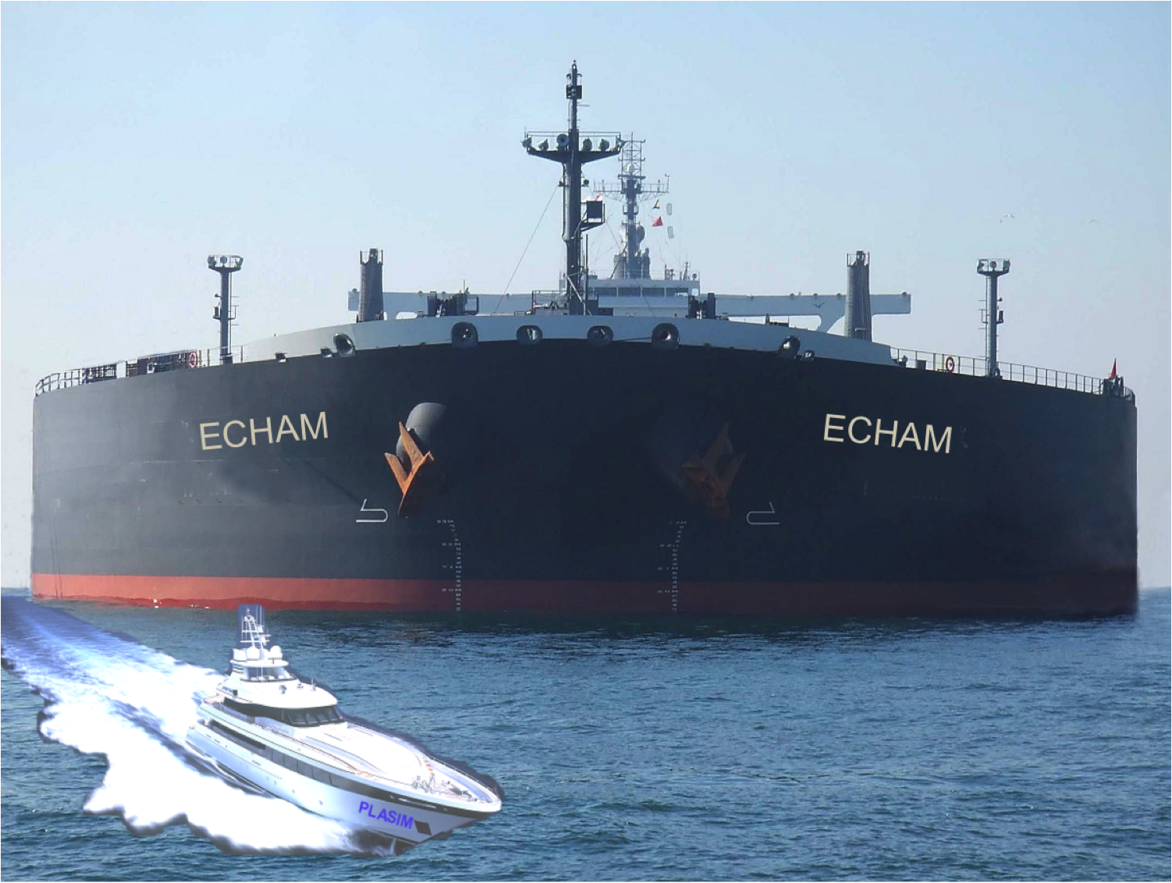

Slide 24
Looking for the big picture
Global structural properties (Saltzman 2002).
Deterministic & stochastic dynamical systems
Example: stability of the thermohaline circulation
Stochastic forcing: ad hoc “closure theory” for noise
Stat Mech & Thermodynamic perspective
Planets are non-equilibrium thermodynamical systems
Thermodynamics: large scale properties of the climate system; definition of robust metrics for GCMs, data
Stat Mech for Climate response to perturbations
EQ NON EQ
24

Slide 25
Disequilibrium in the Earth system
climate
Multiscale
(Kleidon, 2011)

Slide 26
Thermodynamics of the CS
The CS generates entropy (irreversibility), produces kinetic energy with efficiency η (engine), and keeps a steady state by balancing fluxes with surroundings (Ozawa et al., 2003)
Fluid motions result from mechanical work, and re-equilibrate the energy balance.
We have a unifying picture connecting the Energy cycle to the MEPP (L. 2009);
This approach helps for understanding many processes (L et al., 2010; Boschi et al. 2012):
Understanding mechanisms for climate transitions;
Defining generalised sensitivities
Proposing parameterisations

Slide 27
Energy Budget
Total energy of the climatic system:
ρ is the local density
e is the total energy per unit mass
u, φ and k indicate the internal, potential and kinetic energy components
Energy budget

Slide 28
Detailed Balances
WORK
Kinetic energy budget
Potential Energy budget
Total Energy Budget
FLUXES
DISSIPATION

Slide 29
Johnson’s idea (2000)
Partitioning the Domain
Better than it
seems!

Slide 30
Long-Term averages
Stationarity:
Work = Dissipation
Work = Input-Output
A different view on Lorenz Energy cycle

Slide 31
Entropy
Mixing neglected (small on global scale), LTE:
Entropy Balance of the system:
Long Term average:
Note: if the system is stationary, its entropy does not grow → balance between generation and boundary fluxes

Slide 32
Carnot Efficiency
Mean Value Theorem:
We have
Hot Cold reservoirs
Work:
Carnot Efficiency:

Slide 33
Bounds on Entropy Production
Minimal Entropy Production (Landau):
Efficiency:
entropy production entropy fluctuations
Min entropy production is due to dissipation:
and the rest?

Slide 34
Entropy Production
Contributions of dissipation plus heat transport:
We can quantify the “excess” of entropy production, degree of irreversibility with α:
Heat Transport down the T gradient increases irreversibility

Slide 35
Climate entropy budget
Entropy Budget
material EP

Slide 36
MEPP re-examined
Let’s look again at the Entropy production:
If heat transport down the temperature is strong, η is small
If the transport is weak, α is small.
⇓
MEPP: joint optimization of heat transport and of the production of mechanical work

Slide 37
But…
Two ways to compute EP:
Direct vs Indirect
Material vs Radiative

Slide 38
4-box model of entropy budget
EP & Co from 2D radiative fields only
High precision, very low res needed
Poleward transport
1
2
Fluid
Vertical
transport
3
4
Surface
2-box × 2-box

Slide 39
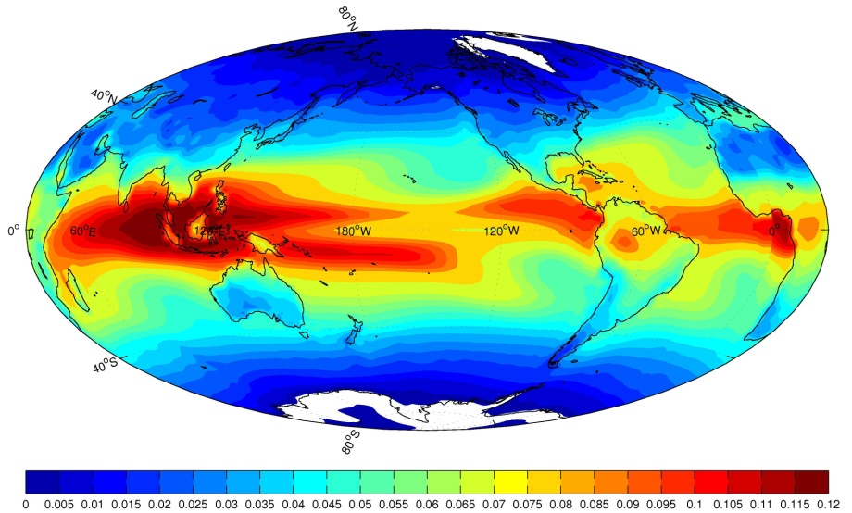
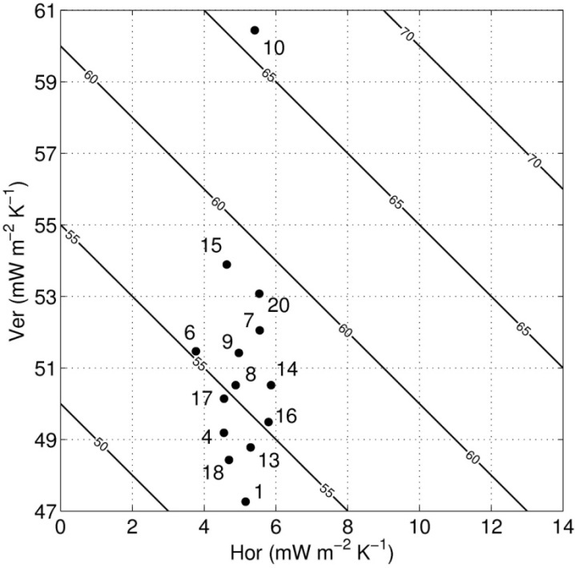
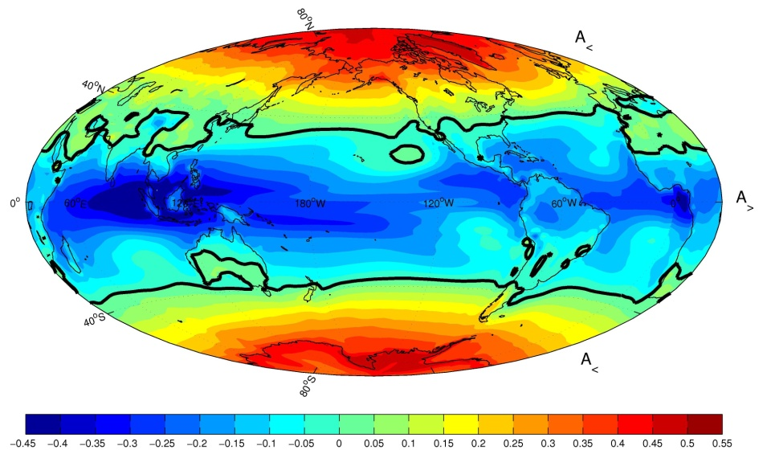
Results on IPCC GCMs
Hor vs Vert EP in IPCC models
Warmer climate:
Hor↓ Vert↑
Venus, Mars, Titan
L., Ragone, Fraedrich, 2011

Slide 41
Suite of Global Intermediate Complexity Models
Atmosphere (spectral)
Shallow Atmosphere Model*
Portable Univ. Model of the Atmosphere*: dynamical core
Planet Simulator: General Circulation Model
* with adjoint version
Ocean
Mixed Layer, Diffusion
Spectral Ocean Model: shallow water
Large Scale Geostrophic
AO-Coupled Mixed Layer – Diff Layer – SOM – LSG
MIT – UVic – NEMO
Laboratory
Direct Numerical Simulation: Rotating Tank

Slide 42
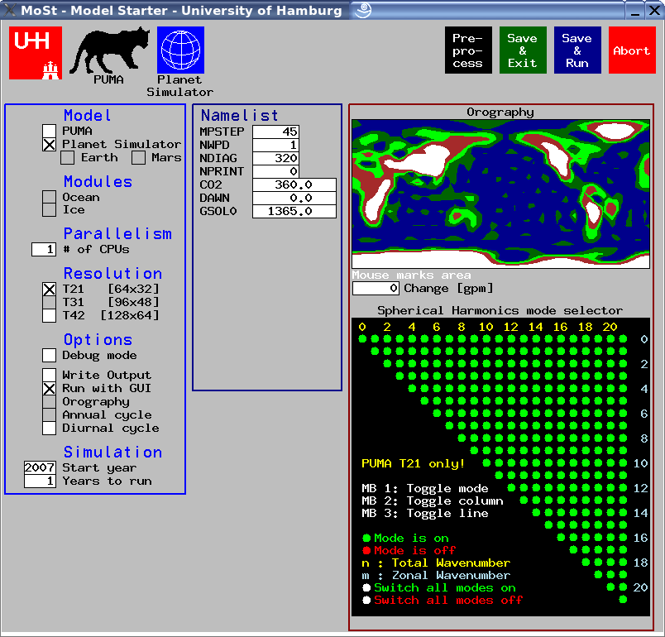
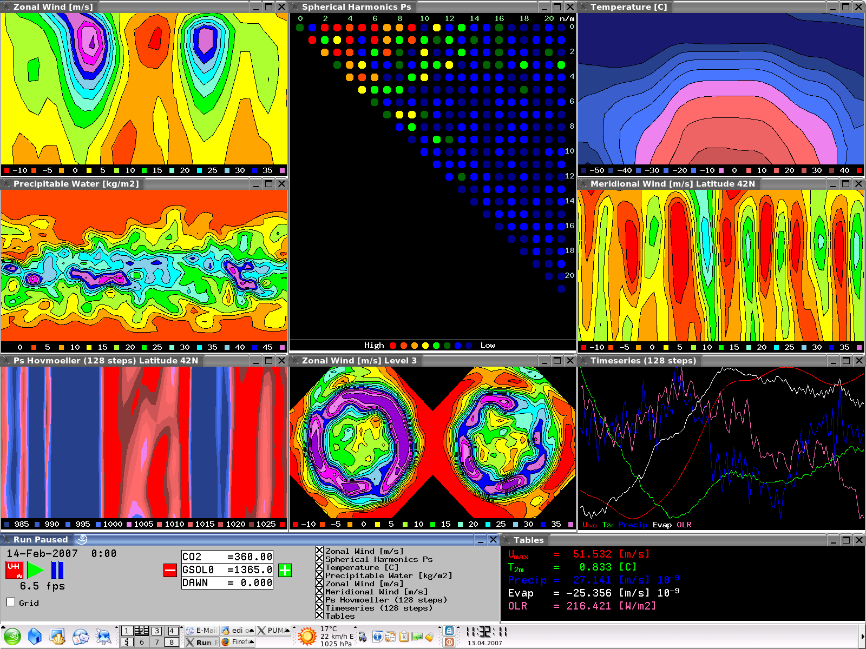
PlaSim: Planet Simulator
Spectral Atmosphere
moist primitive equations on σ levels
Key features
portable
fast
open source
parallel
modular
easy to use
documented
compatible
Sea-Ice
thermodynamic
Vegetations
(Simba, V-code,
Koeppen)
Oceans:
LSG, mixed layer,
or climatol. SST
Terrestrial Surface:
five layer soil
plus snow
Model Starter
and Graphic User Interface

Slide 43
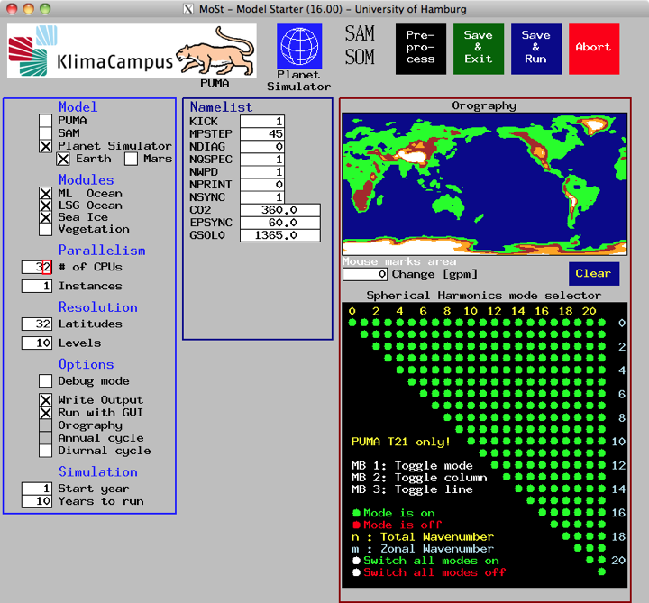
MoSt – The Model Starter
Notes:
In der Eröffnung stellen Sie die Relevanz zwischen dem Thema und Ihr Publikum dar. Geben Sie einen kurzen Überblick über Ihre Präsentation und stellen Sie ihren Wert für Ihr Publikum dar. Beachten Sie das Interesse und die Erfahrung Ihres Publikums bei der Auswahl des Vokabulars, der Beispiele und des grafischen Materials. Fokussieren Sie die Wichtigkeit des Publikums in Bezug auf Ihr Thema und Sie werden aufmerksame Zuhörer haben.

Slide 44
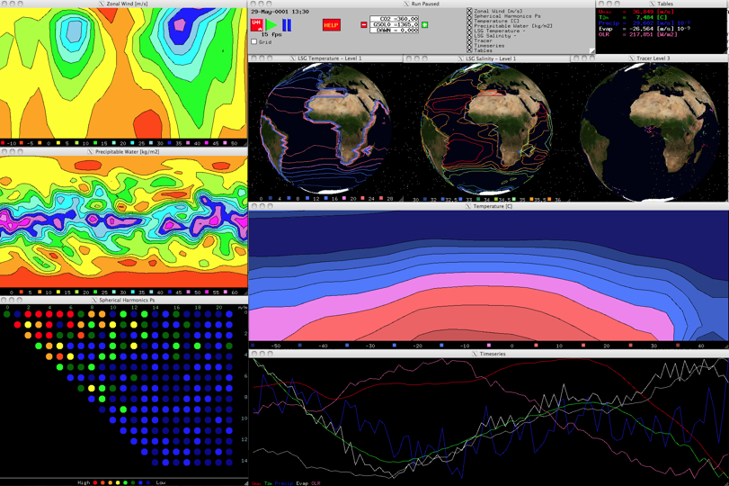

Slide 45
Snowball Hysteresis
Swing of S* by ±10% starting from present climate
→ hysteresis experiment!
Global average surface temperature T_{S}
Wide (~ 10%) range of S* bistable regime -ΔT_{S} ~ 50 K
d T_{S}/d S* >0 everywhere, almost linear
L., Lunkeit, Fraedrich, 2010
W
SB

Slide 46
Thermodynamic Efficiency
d η /d S* >0 in SB regime
Large T gradient due to large albedo gradient
d η /d S* <0 in W regime
System thermalized by efficient LH fluxes
η decreases at transitions→ System more stable
Similar behaviour for total Dissipation
η=0.04↔
Δθ=10K

Slide 47
Entropy Production
d S_{in}/d S* >0 in SB & W regime
Entropy production is “like” T_{S}… but better than T_{S}!
ΔS_{in} is about 400% → benchmark for SB vs W regime
S_{in} is an excellent state variable
System MUCH more irreversible in W state (Bejan)

Slide 48
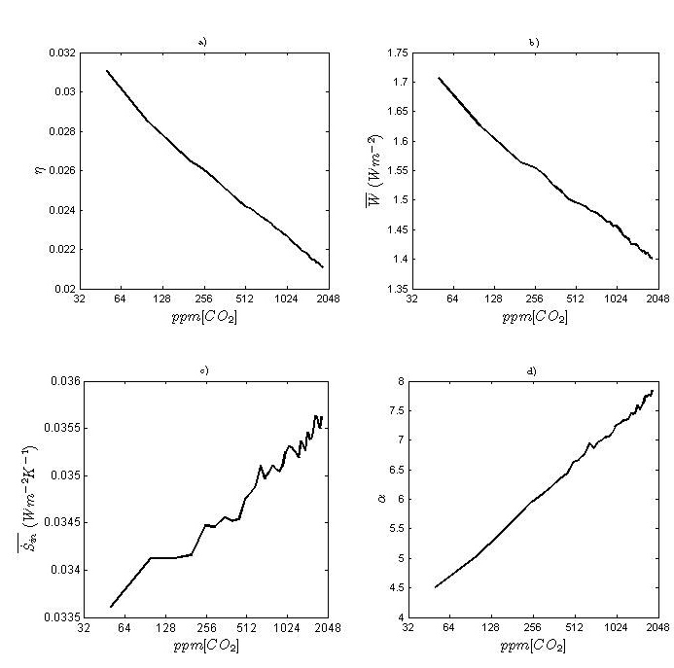
Generalized Sensitivities
CO₂ concentration ranging from 50 to 1750 ppm
→ no bistability!
Efficiency
Energy
Cycle
L., Lunkeit, Fraedrich, 2010
EP
Irreversibility

Slide 49
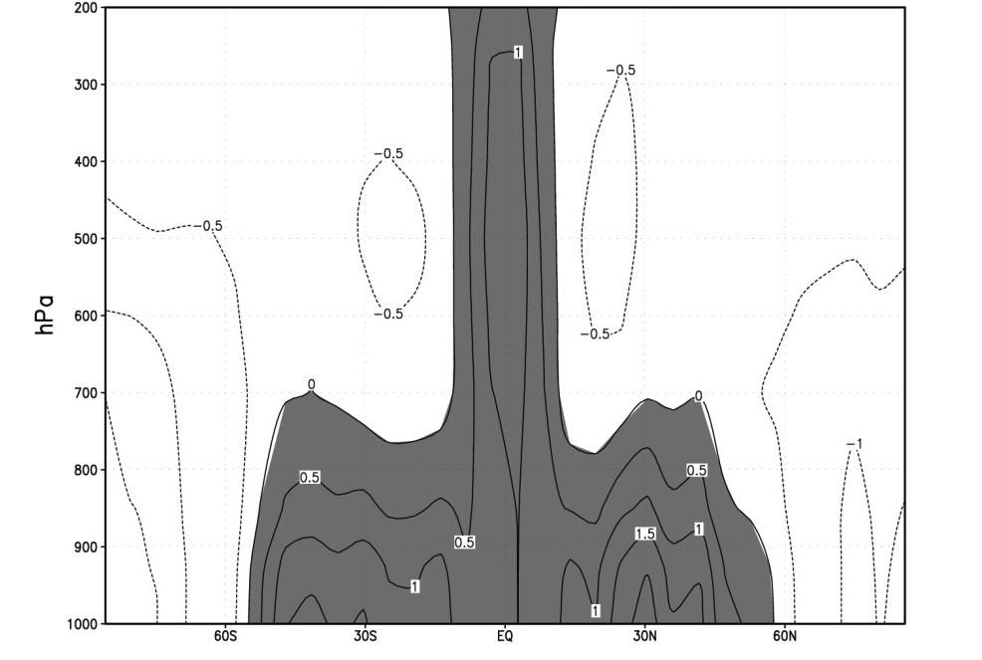
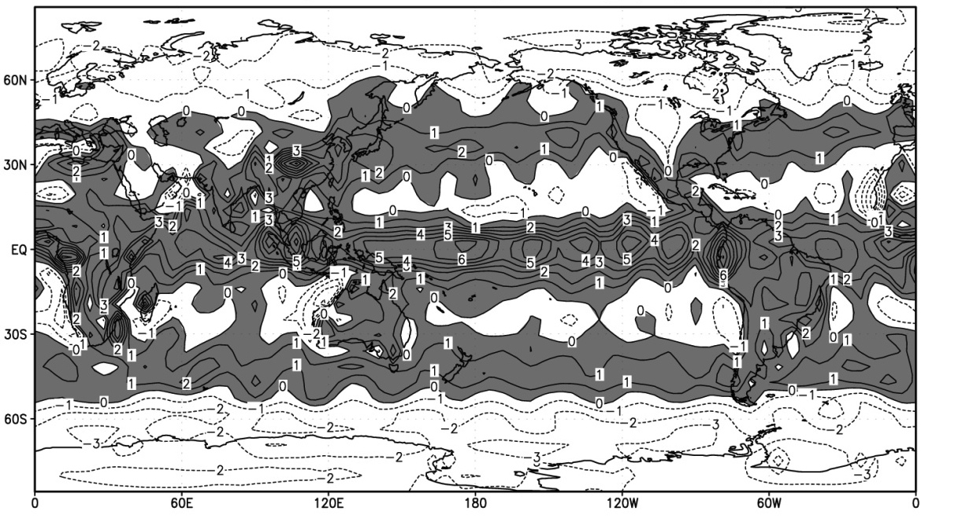
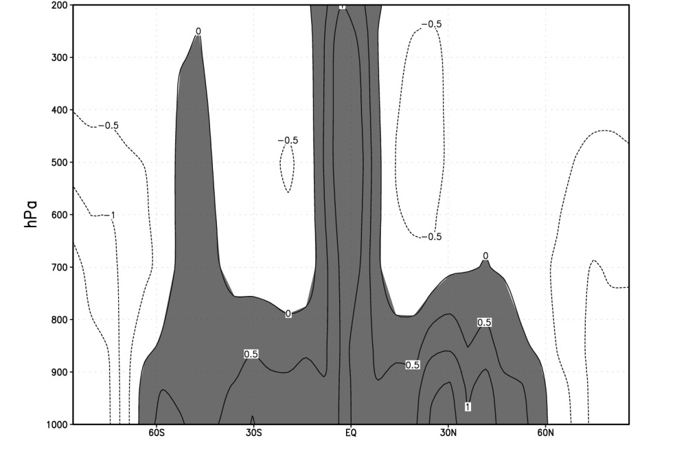
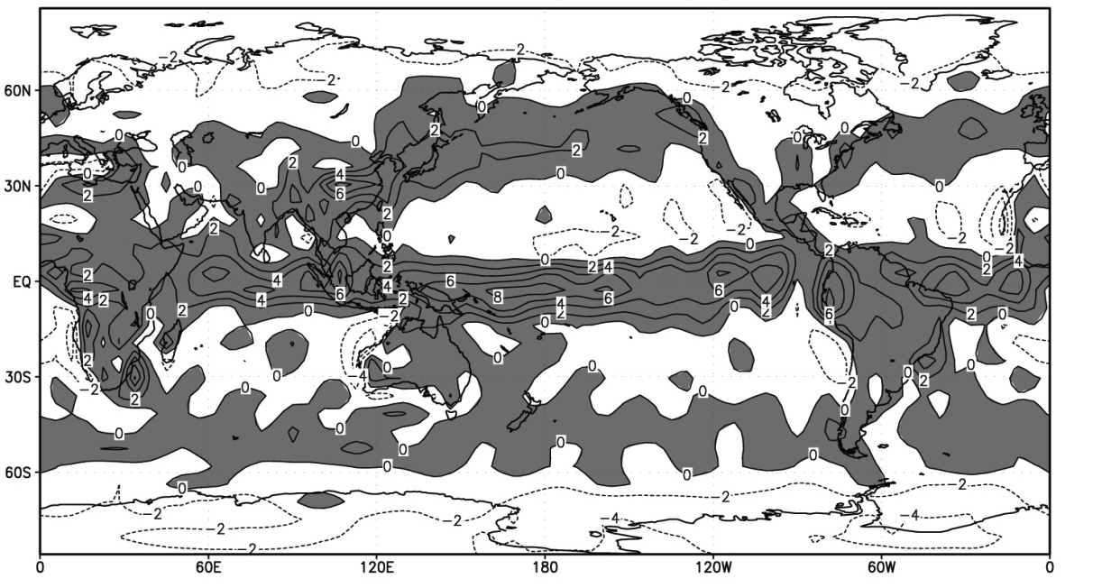
d)
Heating Patterns
100 ppm CO₂
1000 ppm CO₂

Slide 50
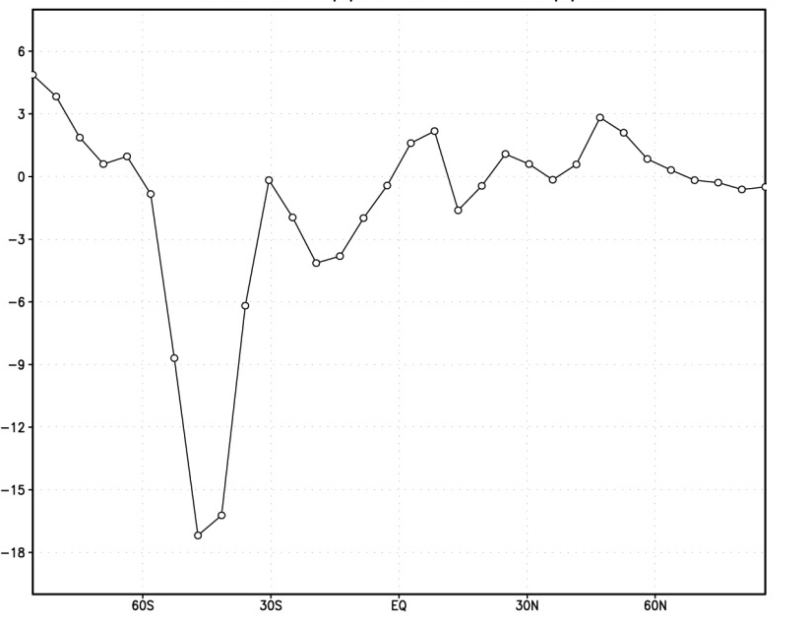
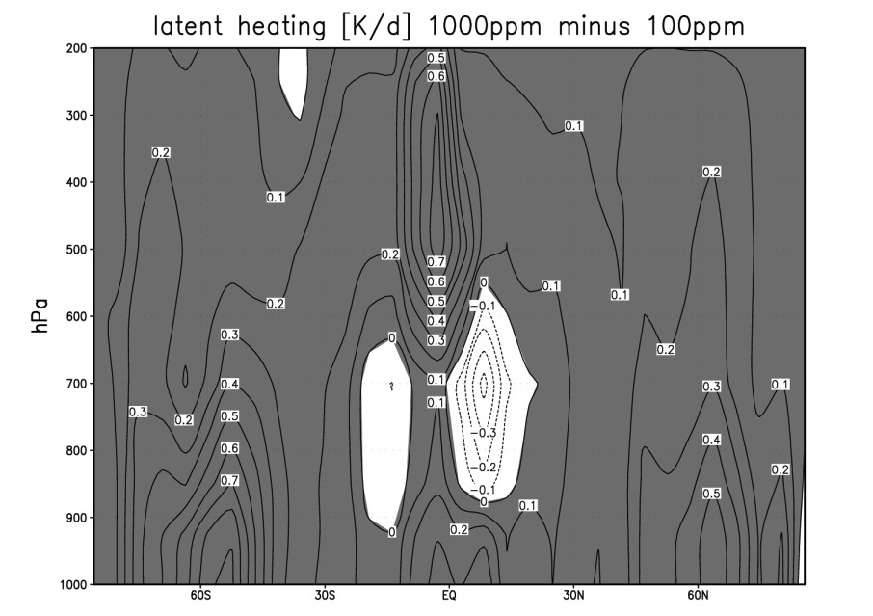
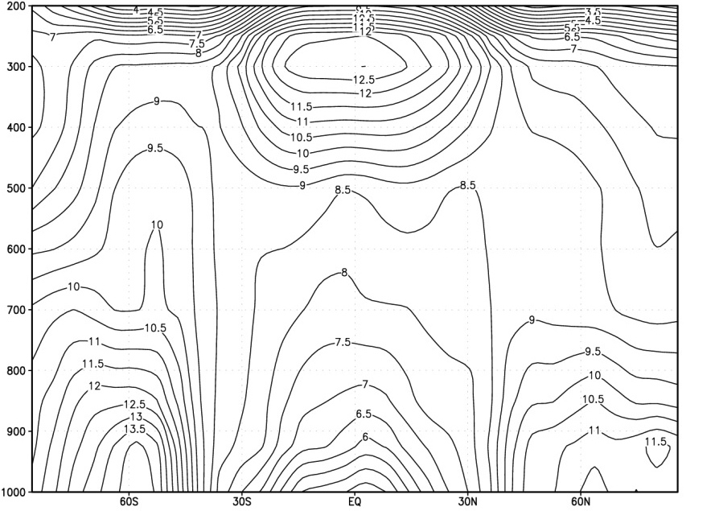
1000-100 ppm Differences
KE @ Surface
Temperature LH Heating

Slide 51
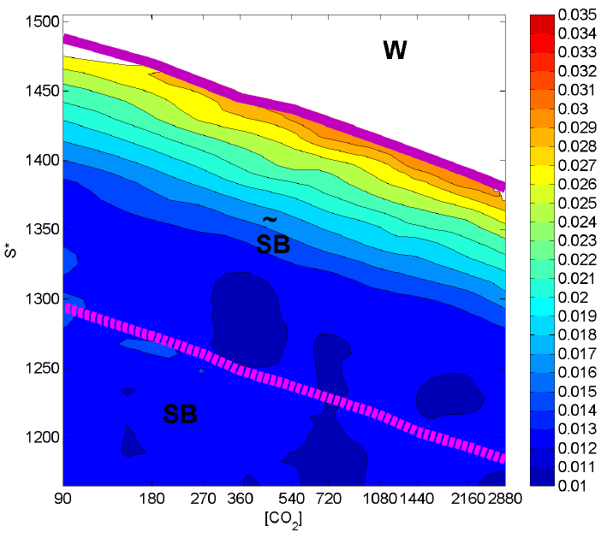
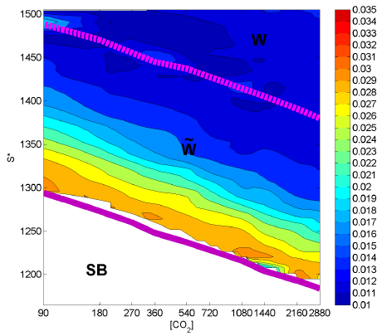
Bringing it together…
Parametric Analysis of Climate Change
Structural Properties of the system (Boschi, L., Pascale 2012)
Lower Manifold Upper Manifold
η
S*
S*
CO₂
CO₂

Slide 52
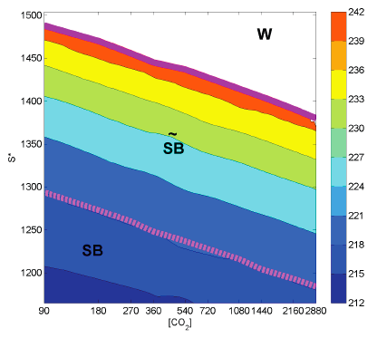
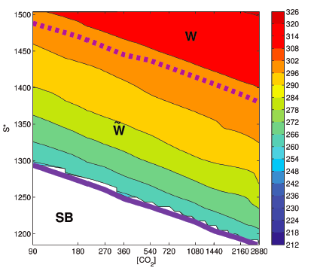
Bringing it together…
Parametric Analysis of Climate Change
Structural Properties of the system (Boschi, L., Pascale 2012)
Lower Manifold Upper Manifold
T_{S}
S*
S*
CO₂
CO₂

Slide 53
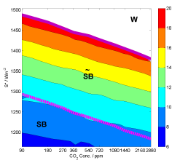
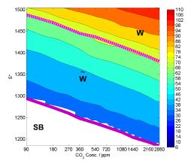
Bringing it together…
Parametric Analysis of Climate Change
Structural Properties of the system (Boschi, L., Pascale 2012)
Lower Manifold Upper Manifold
EP
S*
S*
CO₂
CO₂

Slide 54
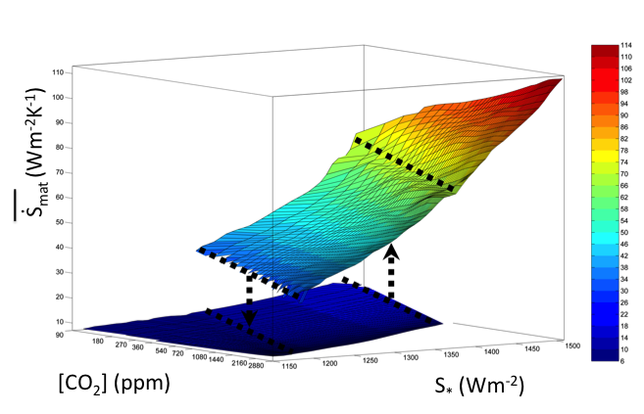
A 3D picture

Slide 55
Is there a common framework?
Going from a 1D to a 2D parameter exploration we gain completeness, we lose compactness
Necessarily so?
Can find an overall equivalence between the atmospheric opacity and incoming radiation perturbations
Concept of radiative forcing…
If so, we gain some sort of universality

Slide 56
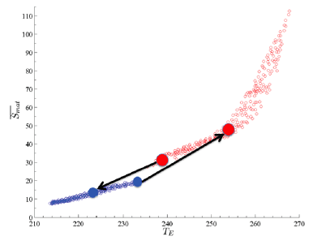
Parametrizations
EP vs Emission Temperature

Slide 57
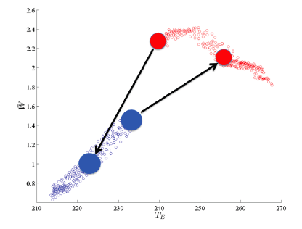
Parametrizations
Dissipation vs Emission Temperature

Slide 58
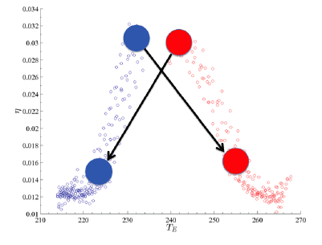
Parametrizations
Efficiency vs Emission Temperature

Slide 59
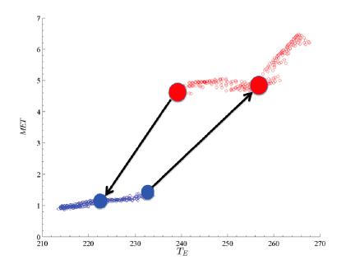
Parametrizations
Heat Transport vs Emission Temperature

Slide 60
Now change the LOD
Will we recover similar relations?

Slide 61
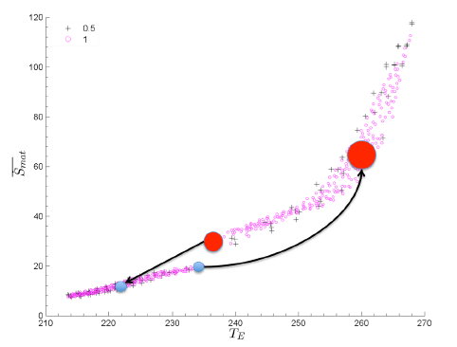
Temp vs EP

Slide 62
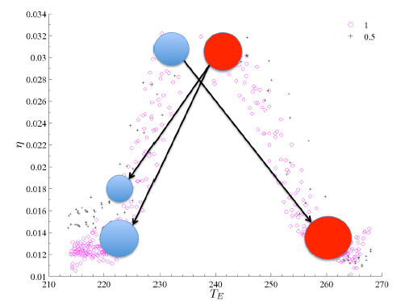
Temp vs Efficiency

Slide 63
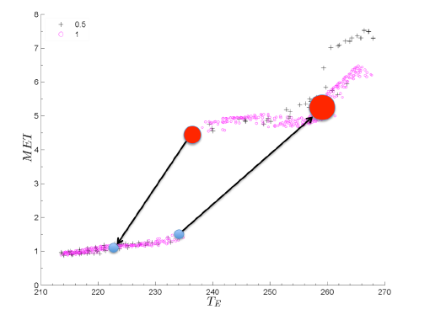
Temp vs Transport

Slide 64
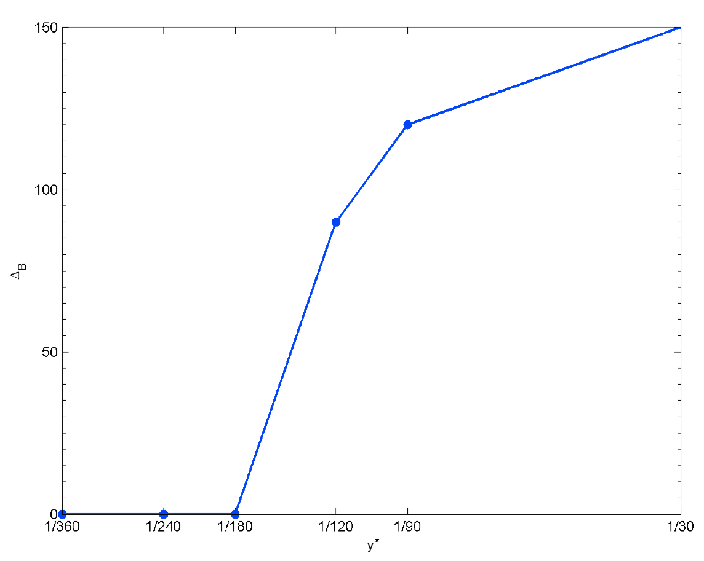
Phase Transition
Width of the bistability vs length year (L. et al. 2013)

Slide 65
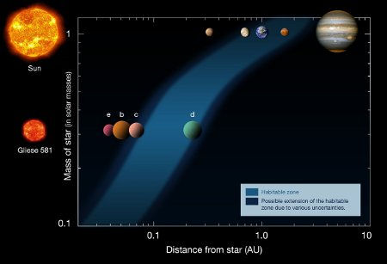
Planetary Atmospheres
Vast range of planetary atmospheres
Rotation rate - Orbital Phase lock
Atmospheric opacities/ incoming radiation
Thermodynamics ➔ habitable super-Earths?

Slide 66
Concluding…
The CS seems to cover many aspects of the science of complex systems
We know a lot more, a lot less than usually perceived
Surely, in order to perform a leap in understanding, we need to acknowledge the different episthemology relevant for the CS and develop smart science tackling fundamental issues
“Shock and Awe” numerical simulations may provide only incremental improvements: heavy simulations are needed, but climate science is NOT just a technological challenge, we need new ideas
I believe that non-equilibrium thermodynamics & statistical mechanics may help devising new efficient strategies to address the problems
Planetary Science!

Slide 67
Bibliography
Boschi R., S. Pascale, V. Lucarini: Bistability of the climate around the habitable zone: a thermodynamic investigation, Icarus (2013)
Held, I.M., The Gap between Simulation and Understanding in Climate Modeling. Bull. Amer. Meteor. Soc., 86, 1609–1614 (2005)
Johnson D.R., Entropy, the Lorenz Energy Cycle and Climate, 659-720 in General Circulation Model Development: Past, Present and Future, D.A. Randall Ed. (Academic Press, 2002)
Kleidon, A., Lorenz, R.D. (Eds.) Non-equilibrium thermodynamics and the production of entropy: life, Earth, and beyond (Springer, 2005)
Lucarini V., Thermodynamic Efficiency and Entropy Production in the Climate System, Phys Rev. E 80, 021118 (2009)
Lucarini, V., K. Fraedrich, and F. Ragone, 2011: New results on the thermodynamical properties of the climate system. J. Atmos. Sci., 68, 2438-2458
Lucarini V., Modeling Complexity: the case of Climate Science, in “Models, Simulations, and the Reduction of Complexity”, Gähde U, Hartmann S, Wolf J. H., De Gruyter Eds., Hamburg (2013)
Lucarini V. S. Pascale, Entropy Production and Coarse Graining of the Climate Fields in a General Circulation Model, sub Clim. Dyn. (2013)
Saltzman B., Dynamic Paleoclimatology (Academic Press, 2002)

