Slide 1
Adatintenzív Genetika
István Csabai, Eötvös University,
Dept. of Physics of Complex Systems, CNL
Statisztikus Fizika Szeminárium, ELTE December 4, 2013.

Slide 2
Evolution of science: early times
theory
observation
reality

Slide 3
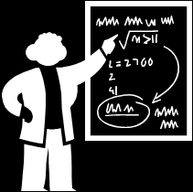
Evolution of science: past
instruments
theory
observation
reality
experiment
models
test
predictions

Slide 4
Evolution of science: present
instruments
theory
observation
reality
experiment
models
test
virtual reality
predictions

Slide 5
Example: the structure of the Solar system
More complex models
Circular orbits
More data
Kepler: data from Tycho Brahe
Elliptical orbits
Gravitational interaction
between planets/moons
Discovery of Neptune
Prediction from models
Chaotic dynamics
Large mirrors, CCD
Satellites
Ring of Jupiter, moons
Asteroid belts
Effects of general relativity
Gravity probe B
? New „planets” beyond Pluto,
dark matter/energy, …?

Slide 6
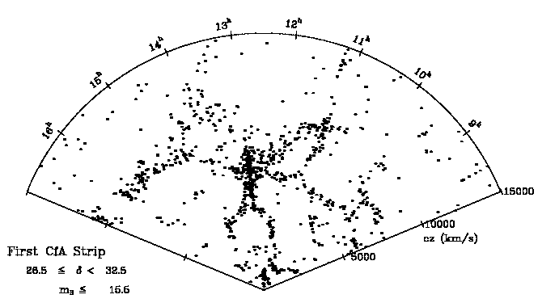
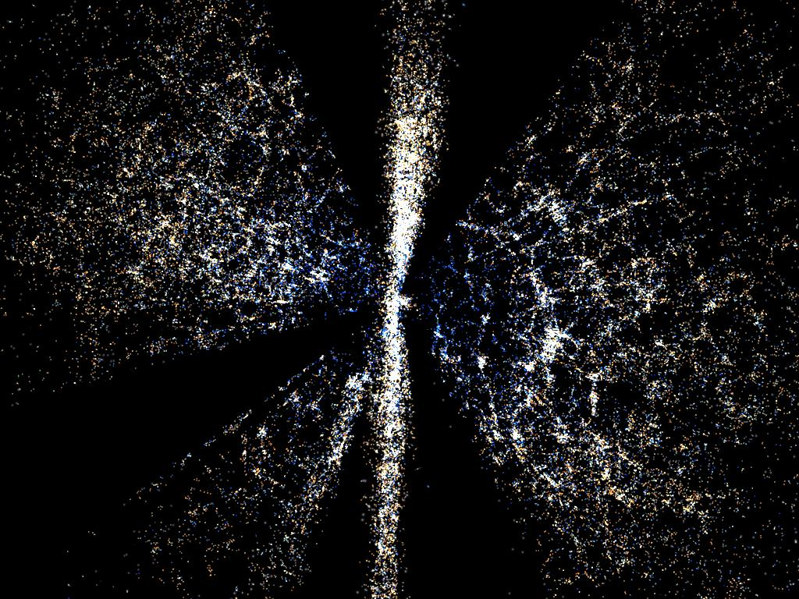
Example: the structure of the Universe
More complex models
1700s: Messier nebulae
’20: Shapley/Curtis, Hubble (Mt. Wilson 100” mirror): galaxies
Clusters, superclusters
’80. Canada-France Redshift Survey
  700 redshifts, 0.14 sq.deg.
  „great wall”
’00: SDSS (CCD)
  1M redshifts, 10000 sq.deg.
  detailed spatial correlation fn.
  cosmological simulations
’20: LSST
  1 week / 5yrs SDSS
More data

Slide 7

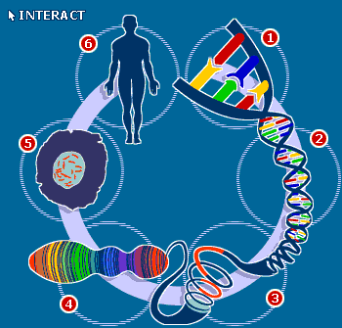
Other disciplines are similar: whole genomes, satellite maps, sensor networks, social networks, etc.
instruments
theory
observation
reality
experiment
models
test
virtual reality
predictions

Slide 8
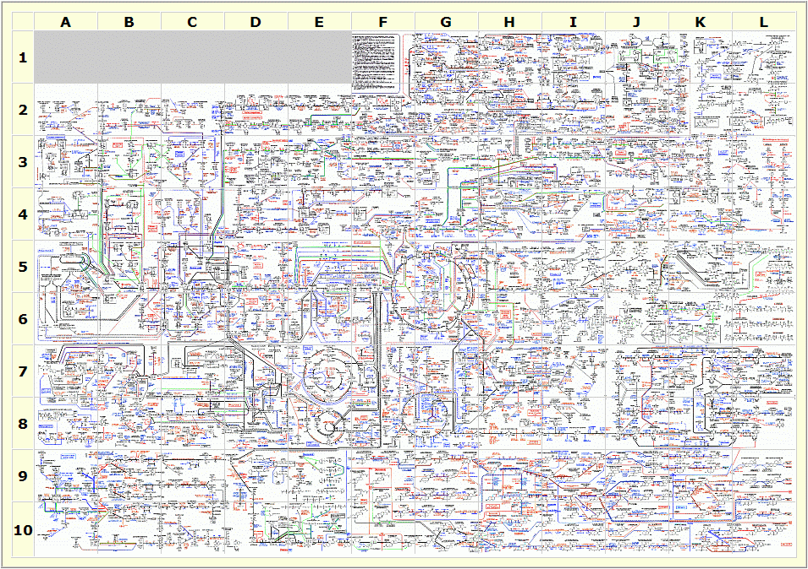
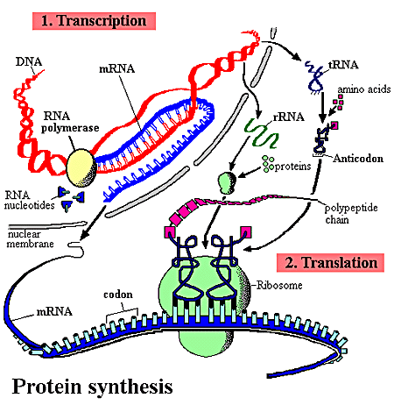
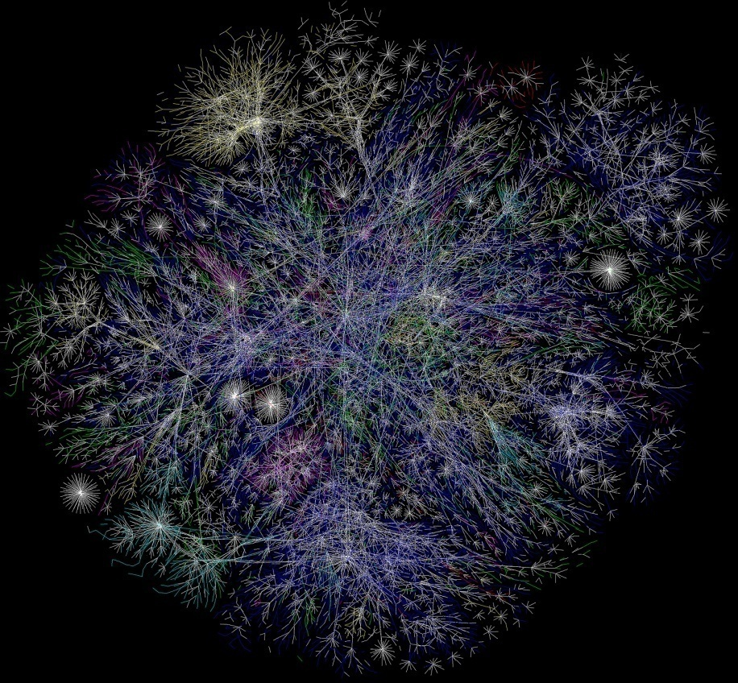
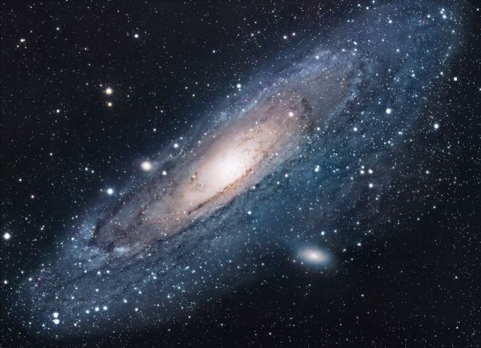
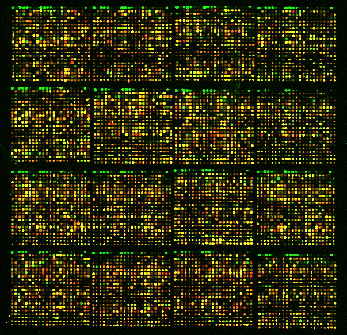
The Universe is a complex system
Galaxies are complex systems
Human cells are complex systems
The society is a complex system
The world economy is a complex system
The Internet is a complex system
…
To understand the complex reality, we need complex models
To verify complex models we need a lot of data and efficient tools

Slide 9
Moore’s law
Gordon E. Moore, a co-founder of Intel : "Cramming more components onto integrated circuits", Electronics Magazine 19 April 1965:
“The complexity for minimum component costs has increased at a rate of roughly a factor of two per year ... Certainly over the short term this rate can be expected to continue, if not to increase. Over the longer term, the rate of increase is a bit more uncertain, although there is no reason to believe it will not remain nearly constant for at least 10 years. That means by 1975, the number of components per integrated circuit for minimum cost will be 65,000. I believe that such a large circuit can be built on a single wafer.”

Slide 10
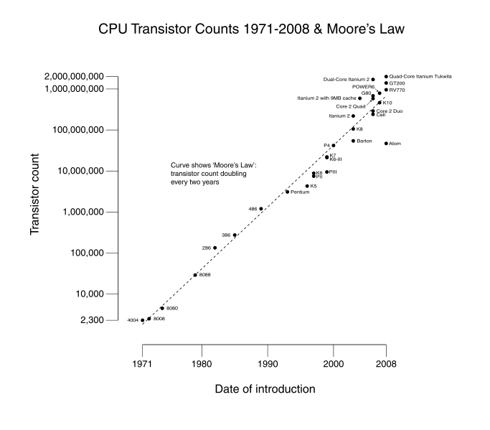
Gordon E. Moore, Intel Chairman, 1965

Slide 11
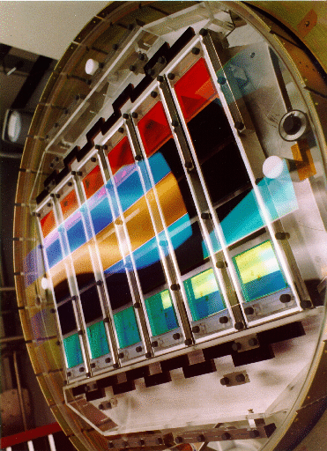
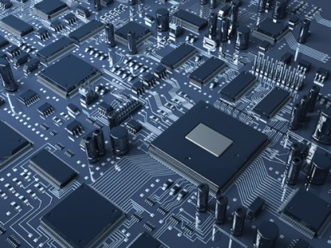
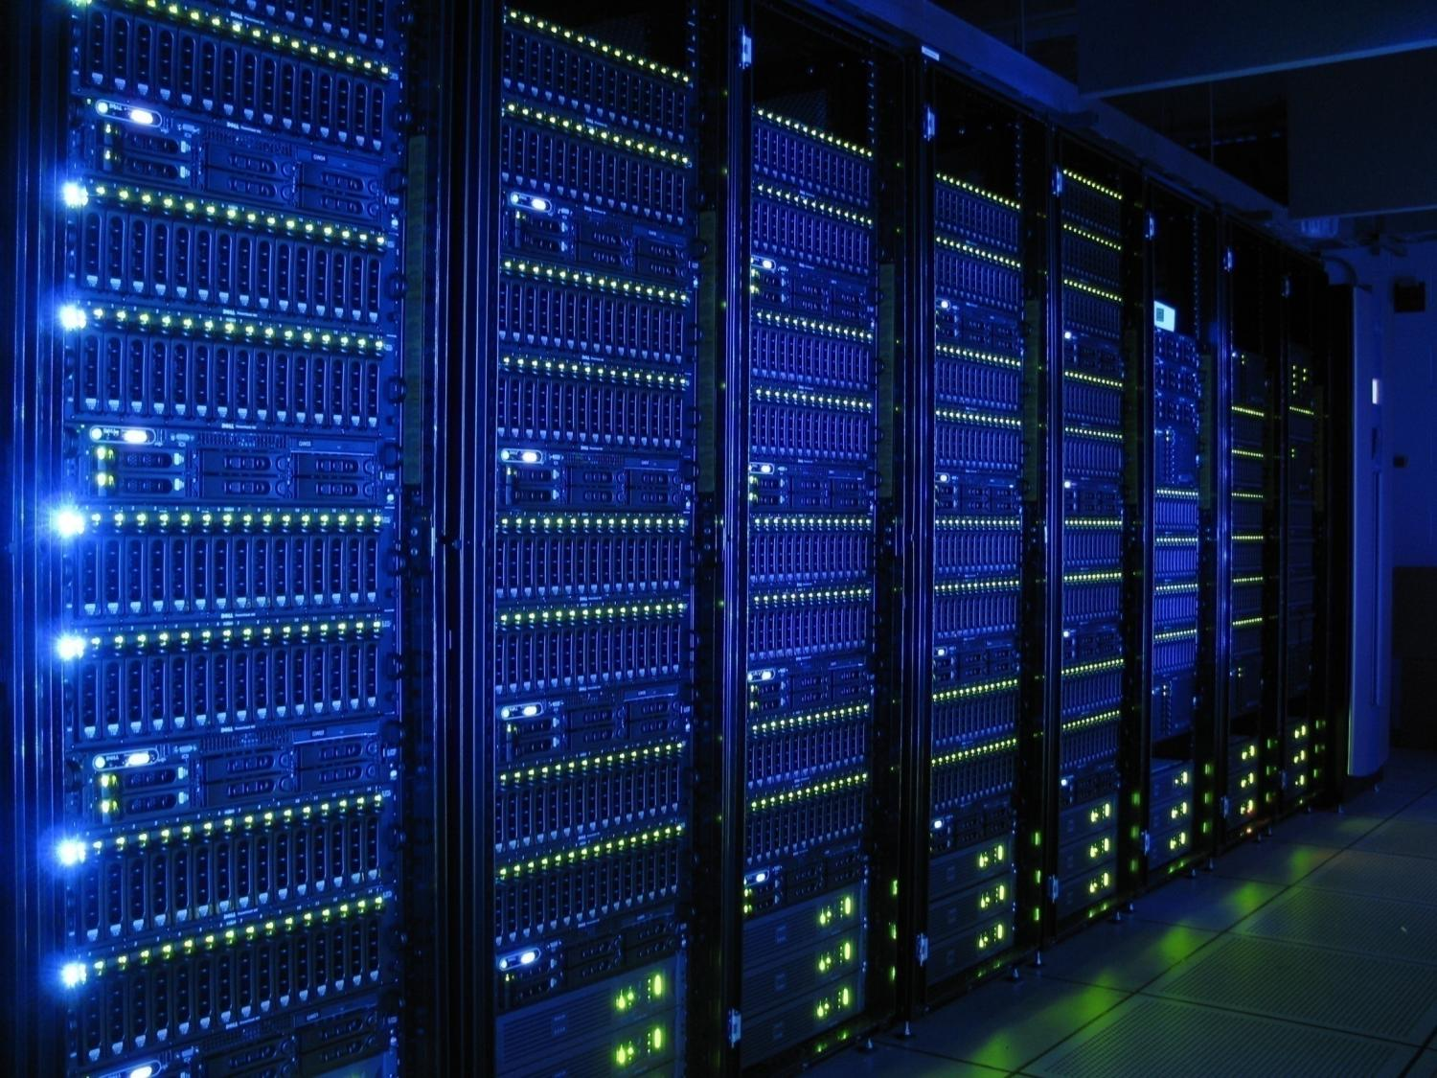
Exponential growth in sciences
Electronics
Detectors
Data

Slide 12
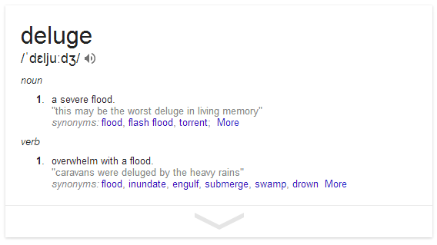

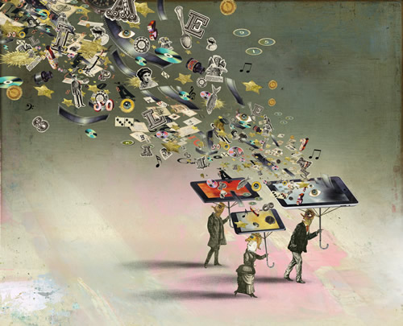

Data deluge in sciences

Slide 13
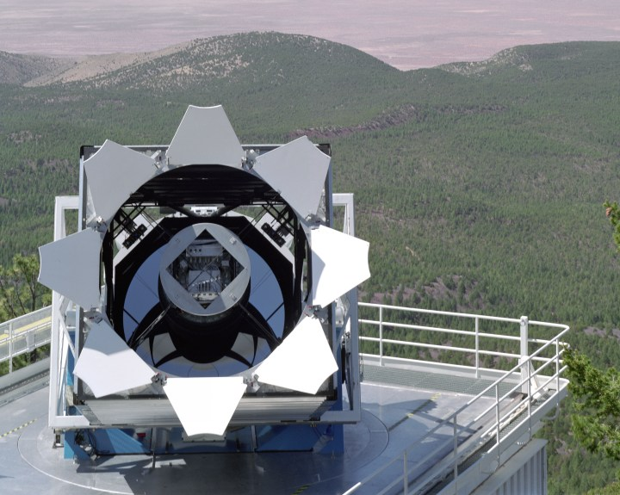
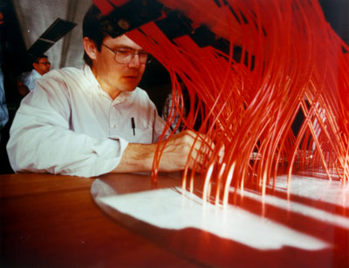
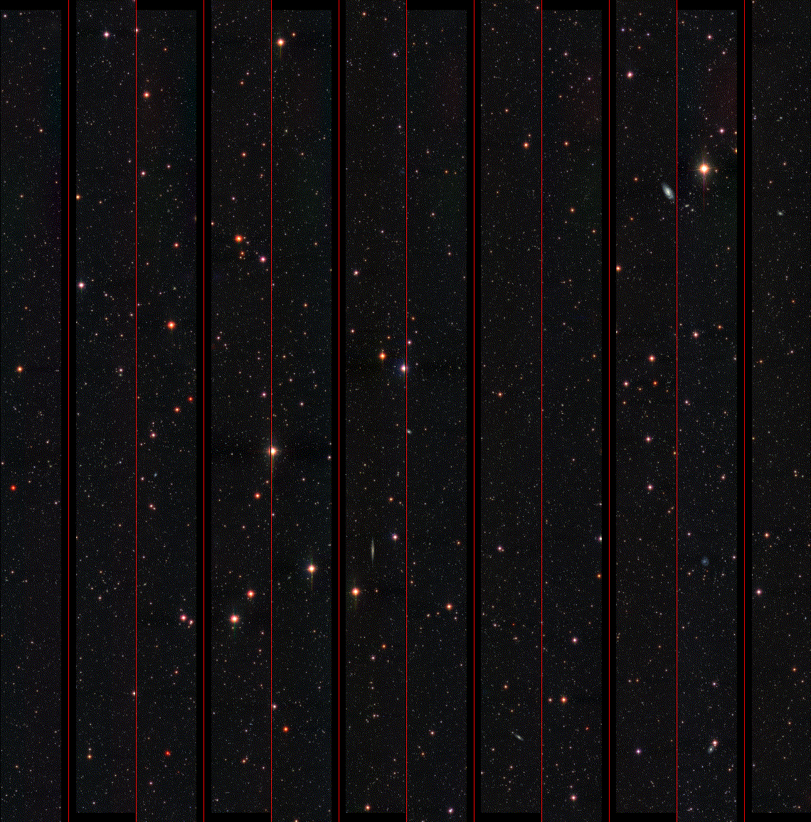
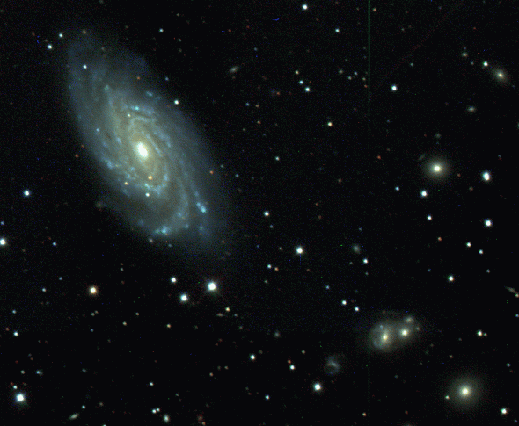
Astronomy: The Sloan Digital Sky Survey
Special 2.5m telescope, located at Apache Point, NM
  3 degree field of view.
  Zero distortion focal plane.
Huge CCD Mosaic: photometry
  30 CCDs 2K x 2K (imaging)
  22 CCDs 2K x 400 (astrometry)
Two high resolution spectrographs
  2 x 320 fibers, with 3 arcsec diameter.
  R=2000 resolution with 4096 pixels.
  Spectral coverage from 3900Å to 9200Å.
Automated data reduction pipeline
  Over 150 man-years of development
  effort.
Very high data volume
  Over 300 million objects, over 300 parameters
  Over 40 TB of raw data, 5 TB catalogs,
  2.5 terapixels
  Data made available to the public.

Slide 14
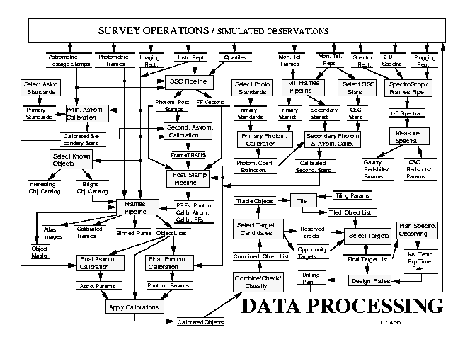
Data Processing Pipeline

Slide 15
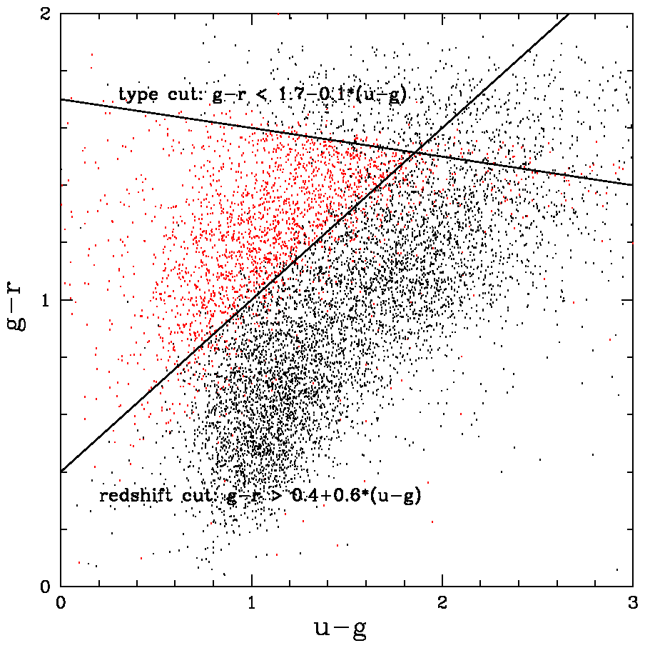
The questions astronomers ask
Star/galaxy separation
Quasar target selection
Combination of inequalities
Multi-dimensional
polyhedron query
  petroMag_i > 17.5 and (petroMag_r > 15.5 or petroR50_r > 2) and (petroMag_r > 0 and g > 0 and r > 0 and i > 0) and ( (petroMag_r-extinction_r) < 19.2 and (petroMag_r - extinction_r < (13.1 + (7/3) * (dered_g - dered_r) + 4 * (dered_r - dered_i) - 4 * 0.18) ) and ( (dered_r - dered_i - (dered_g - dered_r)/4 - 0.18) < 0.2) and ( (dered_r - dered_i - (dered_g - dered_r)/4 - 0.18) > -0.2) and ( (petroMag_r - extinction_r + 2.5 * LOG10(2 * 3.1415 * petroR50_r * petroR50_r)) < 24.2) ) or ( (petroMag_r - extinction_r < 19.5)
  and ( (dered_r - dered_i - (dered_g - dered_r)/4 - 0.18) > (0.45 - 4 * (dered_g - dered_r)) ) and ( (dered_g - dered_r) > (1.35 + 0.25 * (dered_r - dered_i)) ) ) and ( (petroMag_r - extinction_r + 2.5 * LOG10(2 * 3.1415 * petroR50_r * petroR50_r) ) < 23.3 ) )
Skyserver log; a query from the 12 million

Slide 16
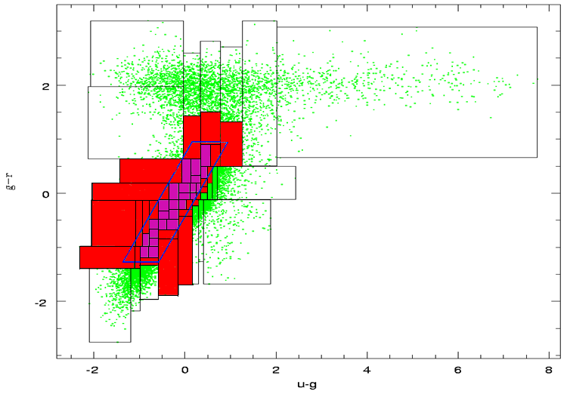
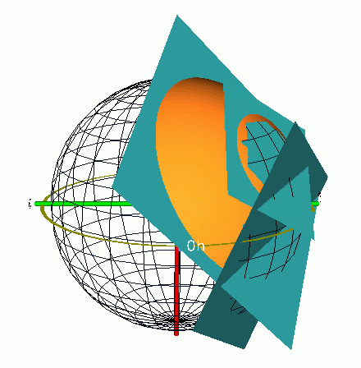
Efficient database indexing (CS)

Slide 17
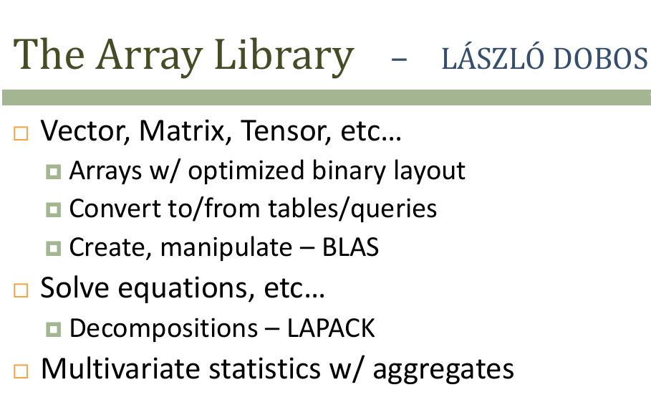

Slide 18
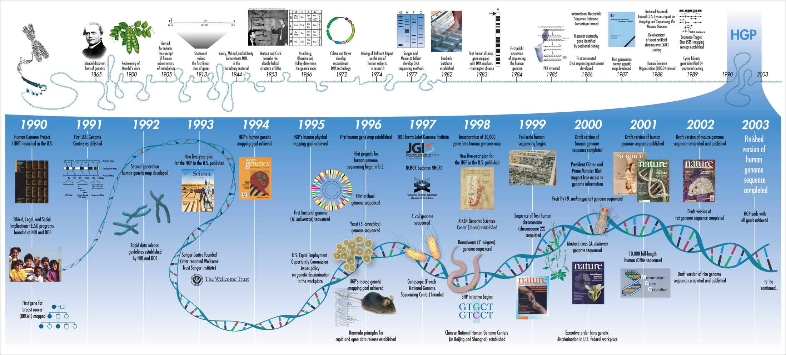
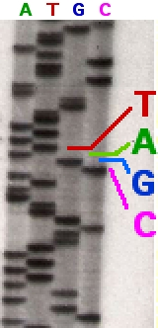
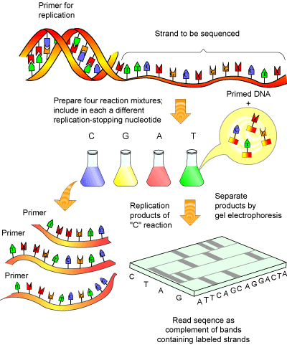
Genomics

Slide 19
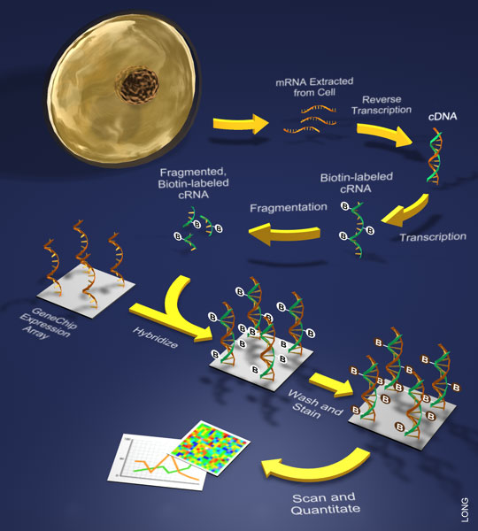

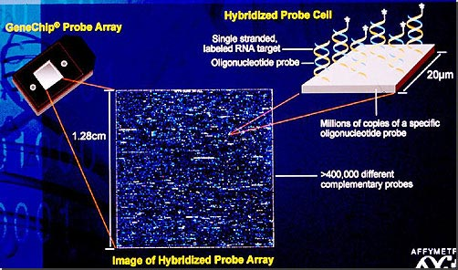
Genomics:Microarrays
Affymetrix HG U133 Plus2
  Raw image 67Mpix (photometry!)
  604258 probes
  54675 probe sets

Slide 20
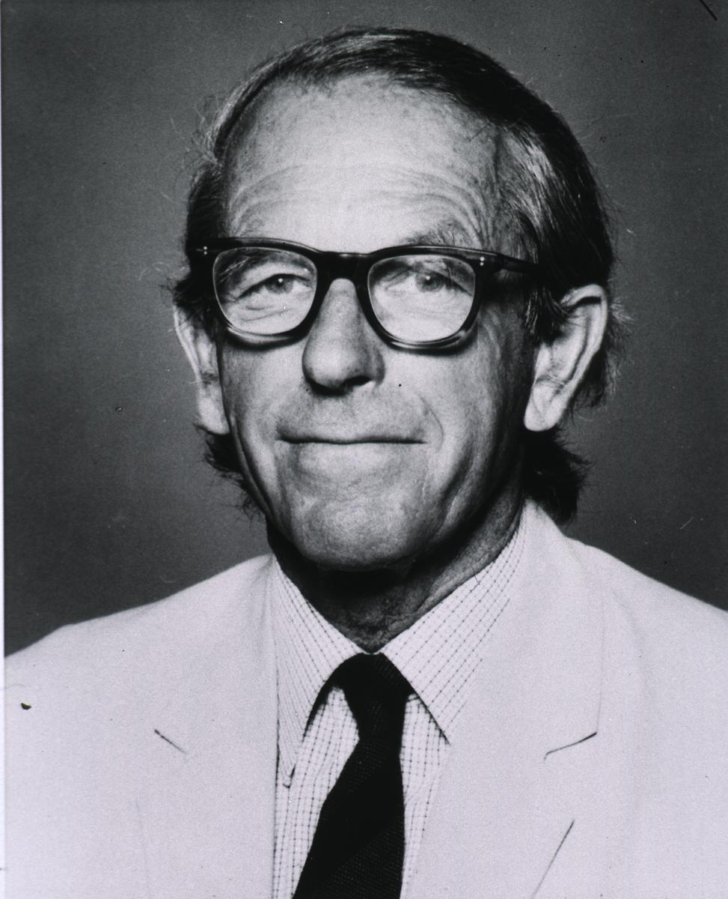
High througput sequencing history: Sanger
1977 Frederick_Sanger
http://en.wikipedia.org/wiki/File:Sequencing.jpg

Slide 21





Main technologies
„Past”:
Solid
http://www.youtube.com/watch?v=nlvyF8bFDwM
http://www.youtube.com/watch?v=l99aKKHcxC4
„Present”:
„Future”:
http://www.youtube.com/watch?v=yVf2295JqUg
https://www.nanoporetech.com/news/movies#movie-24-nanopore-dna-sequencing

Slide 22
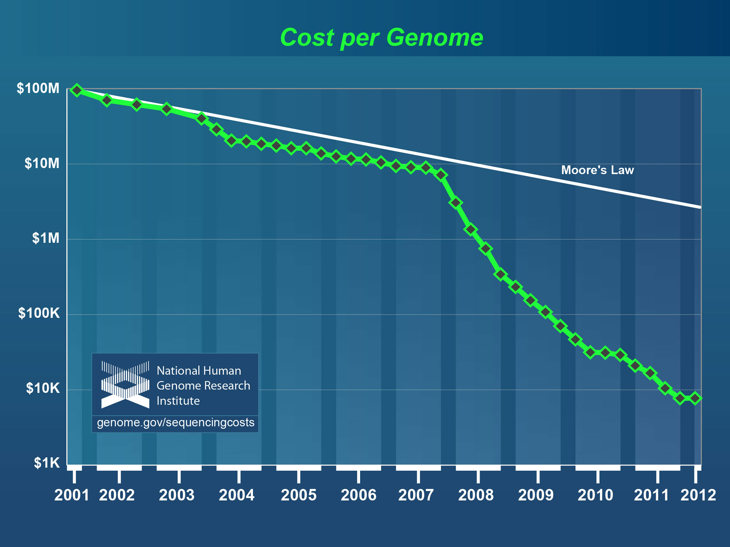
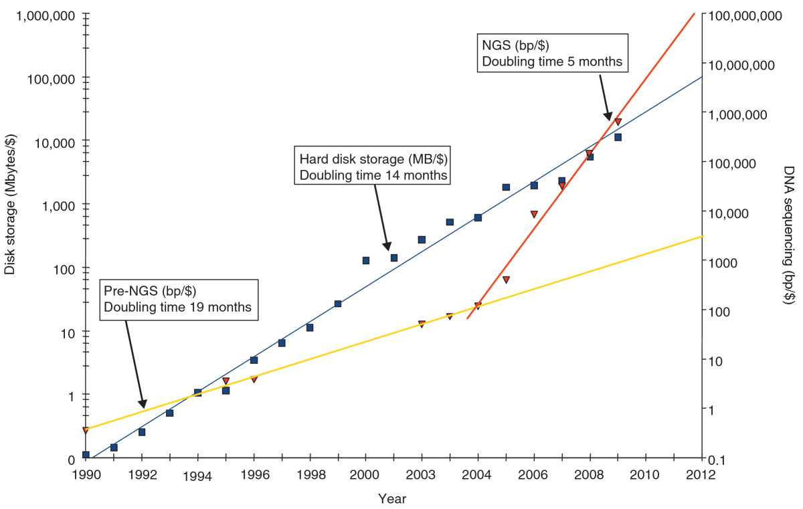
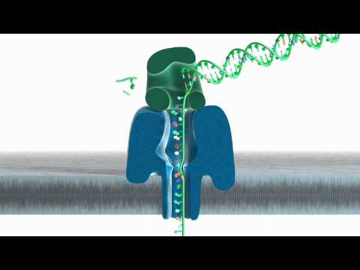
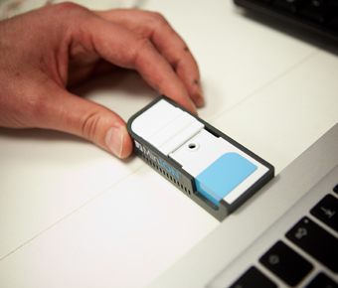
Next Generation Sequencing Data Avalanche
Genome Biol. 2010;11(5):207. Epub 2010 May 5. The case for cloud computing in genome informatics.
Huge genomics archives
Oxford Nanopore
2013 Q4, 100Mb,$900

Slide 23
Genomics Data – Big Data Challenge
Data size per Genome
Structured data
(databases)
Clinical Researchers,
non-infomaticians
Individual
features
(3MB)
Variation data (1GB)
Sequencing informatics
specialists
Alignments (200 GB)
Sequence + quality data (500 GB)
Unstructured data
(flat files)
Intensities / raw data (2TB)
Source: Guy Coates, Wellcome Trust Sanger Institute

Slide 24
Genomics Data – Big Data Challenge
Data size per Genome
Structured data
(databases)
Clinical Researchers,
non-infomaticians
Multiply this with the 7Bn people,
few dozen tissue types for each …
Individual
features
(3MB)
Variation data (1GB)
Sequencing informatics
specialists
Alignments (200 GB)
Sequence + quality data (500 GB)
Unstructured data
(flat files)
Intensities / raw data (2TB)
Source: Guy Coates, Wellcome Trust Sanger Institute

Slide 25
Many other techniques and emerging fields in genetics and other fields of biology:
Mass spectrometry: lipidomics, polysaccharides, …
Digital microscopy
Epigenetics, microRNA, mutation array, …
Microbiome

Slide 26
Now we have more data than
we can/want to store
we can analyse
BUT: we want as much relevant and compressed information as possible
many new improvements in the
computer science / math literature

Slide 27
Dimension reduction

Slide 28
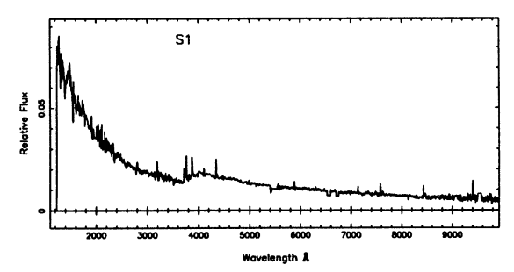
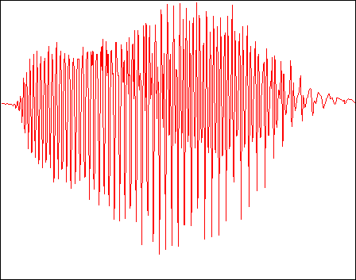
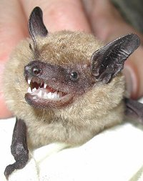
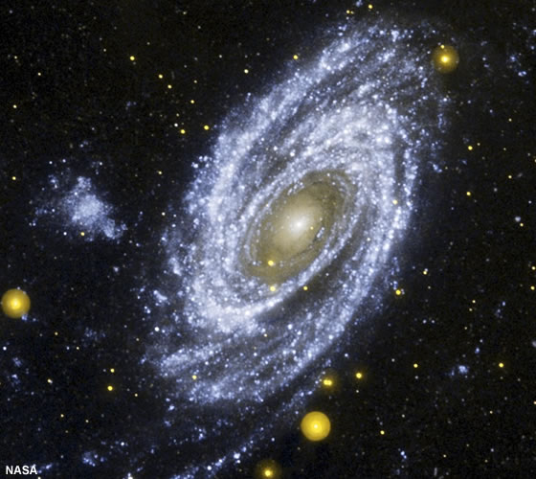
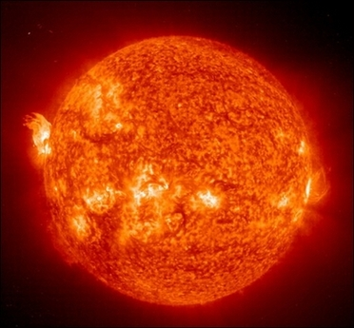
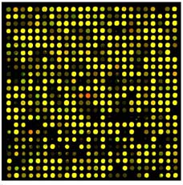
Raw data usually come as high dimensional data vectors

Slide 29
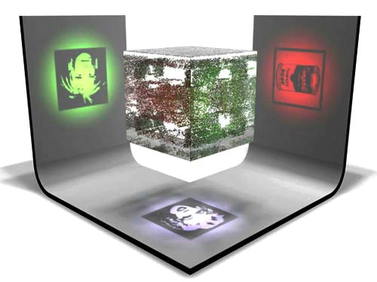
Due to the underlying physical laws, data vectors does not fill the whole space, rather lie on lower dimensional surface/subspace
(this is why we can understand the word!)
Projection ~ compression ~ model

Slide 30
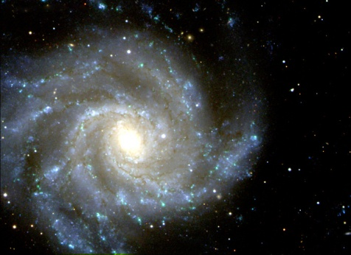
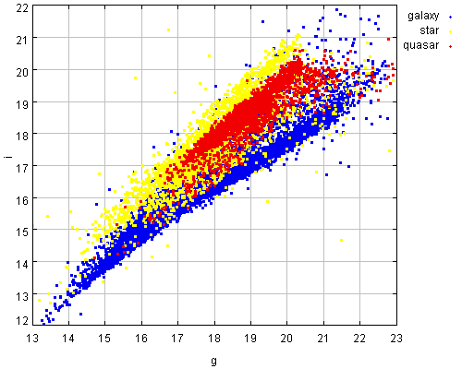

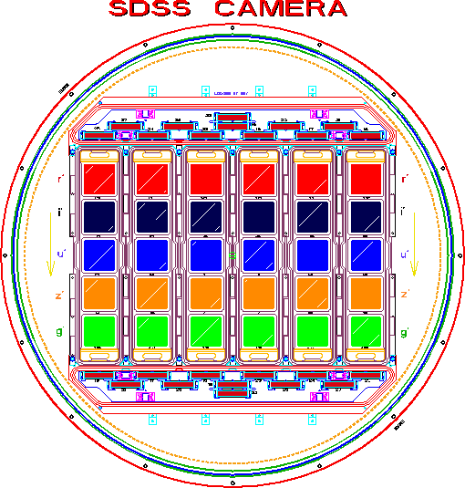

The spectrum and the magnitude „space”
300 million points
in 5+ dimensions
+images
+spectra
- Multidimensional
point data
- highly non-uniform
distribution
- outliers
u g r i z

Slide 31
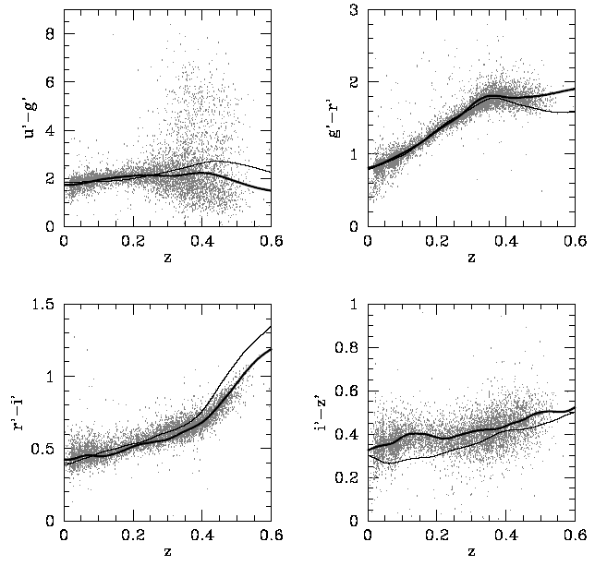
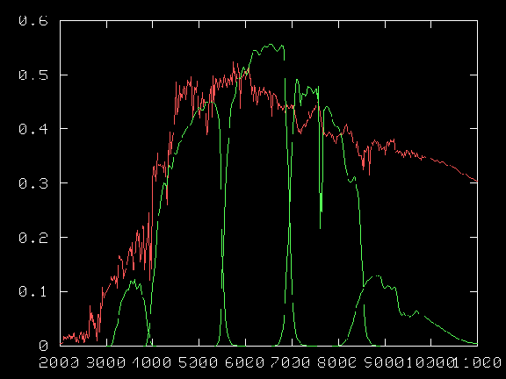
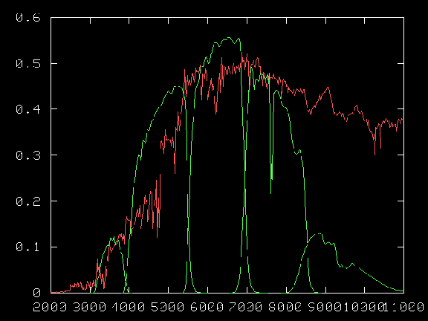
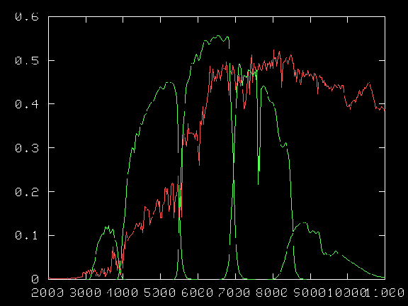
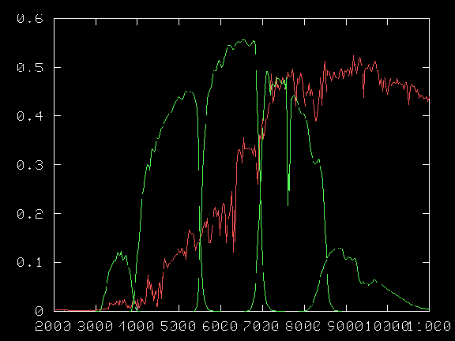
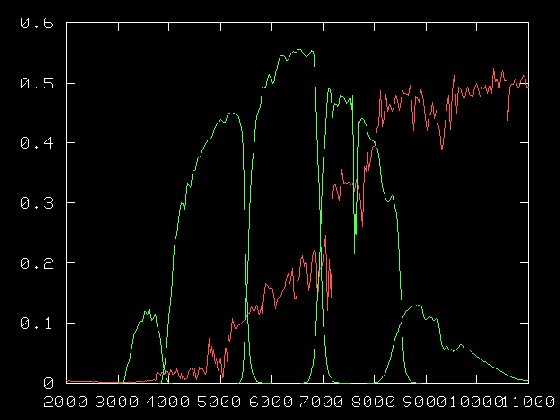


„Natural” projection
LIGHT;
SED
MAGNITUDES, COLORS
BROADBAND FILTERS
REDSHIFT

Slide 32



Model the data an extract
physical parameters:
Age, metallicity, redshifts

Slide 33



„Smart” projection: PCA - SVD
X = UΣV^{T}
X
U
x⁽¹⁾
x⁽²⁾
x^{(M)}
u₁
u₂
u_{k}
Σ
V^{T}
σ₁
v₁
.
σ₂
.
v₂
=
σ_{k}
v_{k}
singular values
input data
left singular
vectors
sorted index

Slide 34



Spectra:
1 million
3000 dimensional vectors

Slide 35


Application: Search for similar spectra
PCA:
AMD optimized LAPACK routines
called from SQL Server
Dimension reduced from 3000 to 5
Kd-tree based nearest neighbor search
Matching with simulated spectra,
where all the physical parameters
are known would estimate age,
chemical composition, etc. of galaxies.

Slide 36

Beyond PCA
PCA eigenvectors
Gene expression
Hard to interpret for the
„domain scientist” and use
in applications : A=CUR
Data does not fit into memory: iterative streaming PCA
Outlier bias: robust PCA
Sparse signals: L₁ metric / linear programming, principal component pursuit
Coefficient matrix

Slide 37
Principal component pursuit
Low rank approximation of data matrix: X
Standard PCA:
  works well if the noise distribution is Gaussian
  outliers can cause bias, „PCA poisoning”
Principal component pursuit
  “sparse” spiky noise/outliers: try to minimize the number of outliers while keeping the rank low
  NP-hard
The L1 trick:
  numerically feasible convex problem (Augmented Lagrange Multiplier)
* E. Candes, et al. “Robust Principal Component Analysis”. preprint, 2009.
Abdelkefi et al. ACM CoNEXT Workshop, 2011 (traffic anomaly detection)

Slide 38


Kulcsmarker azonosítás bioinformatikai analízissel
4. Alprogram 7. részfeladat
Integrált virtuális mikroszkópiai technológiák és reagensek kifejlesztése a vastagbél daganatok diagnosztikájára
3dhist08 : TECH_08-A1/2-2008-0114

Slide 39

Gene microarray: 54675D -> 2D
PCA1 – PCA2
CRC 2
Inflammation (?)
CRC 1
AD2
AD1
IBD2
IBD1
Malignicity (?)
NEG

Slide 40

Marker genes of cancer

Slide 41


What can we find in microarray data?
Enhanced genes
Silenced genes
Cancer markers
Artefacts

Slide 43



Microarray artefacts
Raw image cross-correlation:
bleeding of bright cells
Can be seen in CEL/exprs data, too
Leave out / deconvolution

Slide 44


Cross-hybridization
HGU133Plus2: 604,258 „perfect match” 25-mer sequence
All pairs BLAST: 18M have longer than 12 overlap, 58138 has longer than 15 overlap
Example: overlap=22, Corr.coeff: 0.92
Normal BLAST: strong crosshybr for overlaps above 15
Reverse-complement BLAST: bulk hibridization?

Slide 45

PCA2, PCA3
CRC 2
CRC 1
AD2
AD1
????
IBD2
IBD1
NEG

Slide 46

PCA2, PCA3
Labelling kit !!

Slide 47

Subspaces – ribosome pathway

Slide 48

PCA – KEGG pathways (ribosome)

Slide 49
Next Generation Sequencing adatok kiértékelése
Kihivás:
  2.5 milliárd short read (75 milliárd nukleotid)
  3000 GB adat, 300 processzor, egy-egy illesztés a genom méretétől függően pár óra-egy nap
  Humán genom 3Gbp
  3Gbp x 75Gbp = 2*10²⁰ összehasonlitás !!
Genomok NCBI-ról és más adatbázisokból
Szoftverek: CLC,BWA,bowtie
SAM, BAM, csfasta,fastq, quality
Pileup
Független publikus szekvenálási adatok (SRA)

Slide 50
MW
NEG
IBD
AD
CRC
10000bp
1000bp
100bp
Notes:
cfDNS molekulák méret szerinti elkülönítése agaróz gélelektroforézissel, majd 3 különböző mérettartományban elhelyezkedő frakció izolálása.

Slide 51
Samples – unmapped reads
50 nt read counts:
unmapped raw
NEG 171,868,486 435,893,865
IBD 188,312,509 479,428,724
AD 142,9447,68 574,360,089
CRC 434,283,838 1,060,302,687
Human genome unmapped portions:
NEG 39.4%
IBD 39.2%
AD 24.8%
CRC 40.9%

Slide 52

E.coli IAI1 NEG találatok

Slide 53

E.coli IAI1 CRC találatok
CRC: ugyanakkora lefedettség
de csúcsokban!
Figyelem! Logaritmikus skála !

Slide 54

E.coli IAI1 NEG találatok (zoom)
Hiány

Slide 55

E.coli IAI1 CRC találatok (zoom)
Nem csak mennyiségben, hanem
jellegében is nagy eltérés.
Csúcs
A csúcsoknál az annotáció
bakteriofág géneket mutat.

Slide 56
Virusok – bakteriofágok illesztése
virus adatbázis: 1773 virus genom
többnyire E. coli és más enterobacter fágok és rokonai kapnak találatot
nagy valószinűséggel nem véletlen hiba és nem is kontamináció,
de további vizsgálatot igényel
A genomon ennyi pozicióra
illett short read (lehet hogy nagyon
sokszor, azt a statisztikát itt nem mutatjuk)
==> results/virusesAD.list <==
gi|9626243|ref|NC_001416.1| 307 Enterobacteria phage lambda
gi|9632466|ref|NC_000924.1| 56 Enterobacteria phage 933W
gi|20065797|ref|NC_003525.1| 56 Stx2 converting phage I
gi|110801439|ref|NC_008262.1| 53 Clostridium perfringens SM101 chromosome
gi|31044225|ref|NC_004813.1| 50 Enterobacteria phage BP-4795
==> results/virusesCRC.list <==
gi|9626243|ref|NC_001416.1| 466 Enterobacteria phage lambda
gi|110801439|ref|NC_008262.1| 163 Clostridium perfringens SM101 chromosome
gi|9632466|ref|NC_000924.1| 99 Enterobacteria phage 933W
gi|20065797|ref|NC_003525.1| 99 Stx2 converting phage I
gi|31044225|ref|NC_004813.1| 84 Enterobacteria phage BP-4795
==> results/virusesIBD.list <==
gi|281199644|ref|NC_013594.1| 2039 Escherichia phage D108
gi|9633494|ref|NC_000929.1| 1943 Enterobacteria phage Mu
gi|9626243|ref|NC_001416.1| 613 Enterobacteria phage lambda
gi|30065704|ref|NC_004745.1| 554 Yersinia phage L-413C
gi|110801439|ref|NC_008262.1| 487 Clostridium perfringens SM101 chromosome
==> results/virusesNEG.list <==
gi|9633494|ref|NC_000929.1| 1073 Enterobacteria phage Mu
gi|281199644|ref|NC_013594.1| 1066 Escherichia phage D108
gi|9626243|ref|NC_001416.1| 583 Enterobacteria phage lambda
gi|30065704|ref|NC_004745.1| 484 Yersinia phage L-413C
gi|9630327|ref|NC_001895.1| 310 Enterobacteria phage P2

Slide 57
Virusok – bakteriofágok illesztése
Az E. coli és a bakteriofágok komplementer lefedettséget mutatnak
Véletlen vagy enterobaktériumok és fágjaik mint rák markerek?
Több és nem poolozott minta kellene!

Slide 58

Régebbi expressziós vizsgálatok
Egy meglepő klasszifikáló gén:
AFFX-BioDn-3_at , AFFX-CreX-5_at (nem human hibridizációs kontroll gének „markerként” viselkednek a vér mintákon
(1:normal, 2:adenoma, 3:cancer B 4: cancer C)
?? HIBÁS minta ???
!! NEM HIBA: MAQC mintákon ugyanez látszik !!
A BioDn-3 E. coli eredetű, a CreX-5 pedig bakteriofág gén.
Véletlen egybeesés?

Slide 59
További baktériumok: mRNA 16s
A riboszomális RNS evolúciósan konzervativ
Fajok közt kis különbségek: filogenetikai vizsgálatokra alkalmas
Adatbázis: 711278 baktérium törzs mRNS 16s szekvenciája
A short read szekvenciák illesztése: más baktériumok jelenléte
A fajok közötti homológiák miatt (jelen van egy faj vagy az E. coli rokonság miatt kap találatot ) további vizsgálatot igényel
Egy meglepetés:
  Az IBD mintán az E.coli és enterobakter rokonai (Shigella, Salmonella) mellett egy nem közeli rokon: ”Lycopersicon esculentum bacterium” van a találati lista elején

Slide 60

Paradicsom
A paradicsom genom hézagosan de széleskörűen le van fedve
Az IBD jóval nagyobb lefedettséget mutat mint a többi minta
  IBD : 36127 pozició
  NEG: 3891 , AD: 523, CRC: 3070
Elsősorban a kloroplasztisz gének vannak lefedve (érthető: a humán mintán pedig a mitokondrium)
Kloroplasztisz adatbázis: 220 növény kloroplasztisz-szekvenciája -> illesztés
A krumpli valamivel nagyobb lefedettséget mutat, a paradicsom lehet, hogy csak a rokonság miatt jön be
Solanum lycopersicum
kloroplasztisz
gi|294768541|ref|NC_008096.2| 11262 Solanum tuberosum chloroplast,
gi|91208967|ref|NC_007943.1| 10998 Solanum bulbocastanum chloroplast
gi|149384932|ref|NC_007898.2| 10483 Solanum lycopersicum chloroplast
gi|81238323|ref|NC_001879.2| 9085 Nicotiana tabacum plastid
gi|78102509|ref|NC_007500.1| 9084 Nicotiana sylvestris chloroplast
gi|28261696|ref|NC_004561.1| 9002 Atropa belladonna chloroplast,
gi|81301540|ref|NC_007602.1| 8893 Nicotiana tomentosiformis chloroplast
gi|334701598|ref|NC_015608.1| 5195 Olea woodiana subsp. woodiana chloroplast
gi|334700261|ref|NC_015604.1| 5172 Olea europaea subsp. cuspidata chloroplast
gi|330850722|ref|NC_015401.1| 5172 Olea europaea subsp. europaea plastid
kromoszómák

Slide 61


Slide 62







Slide 63



Slide 64

Verification: Independent samples from public databases
Inflammation?

Slide 65


Fragment size ?

Slide 66


Slide 67

Log-normal distribution

Slide 68
New kind of science …
We have extended our eyes
  10 m telescope = 4 million pupils
We have extended our retina
  SDSS 120 Mpix camera, total footprint 1M x 1M pixels
We are extending our brains, too …
  Complex models: computer simulations
    Millennium run, galaxy models, etc.
  Huge amount of observed data
    Past: the major bottleneck was the lack of data
    Now: the bottleneck is handling large amount of complex data
The new discovery process will rely heavily on
    advanced data management, visualization
    statistical analysis tools
    knowledge integration

Slide 69
… new kind of scientists
ITΠ
Beyond the traditional skills
  advanced math: calculus, statistics, etc.
  physics and astronomy / biology / sociology
You need good computational skills:
  Parallel computing, large scale simulations
  Database technology, SQL, indexing techniques
  Web technologies
  Data mining, machine learning, visualization, …

Slide 70









Acknowledgements
Ács Zoltán
Mátray Péter
Laki Sándor
Stéger József
Vattay Gábor
Solymosi Norbert
Bodor András
Kondor Dániel
Dobos László
Varga József
Trencséni Márton
Purger Norbert
Ittzés Péter
Spisák Sándor
Molnár Béla
Budavári Tamás
Szalay Sándor
Universidad Autonoma de Madrid
Universidad Publica de Navarra
Ericsson Research
Tel Aviv University
Johns Hopkins University
Semmelweis University
NKTH TECH08:3dhist08
NAP 2005/ KCKHA005, Polányi
OTKA-103244
OTKA 7779
EU ICT OneLab2 IP #224263
EU FIRE NOVI #257867
EIT KIC
NFÜ-KMR 12-1-2012-0216
MaKog Foundation

Slide 71
Eddig szinte semmit se tudtunk.
Végtelen lehetőségek nyílnak meg …
… a rák gyógyítása, szignifikánsan hosszabb egészséges élet …
Egy kérdés vár csak válaszra:
Meg tud javítani egy biológus egy rádiót?

